Slide 1
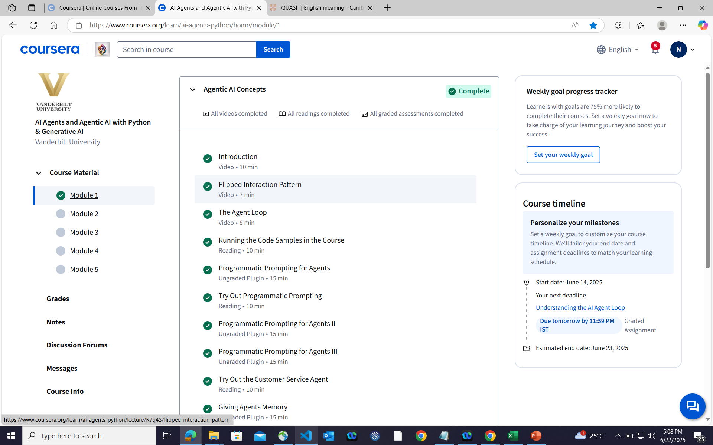

Slide 2
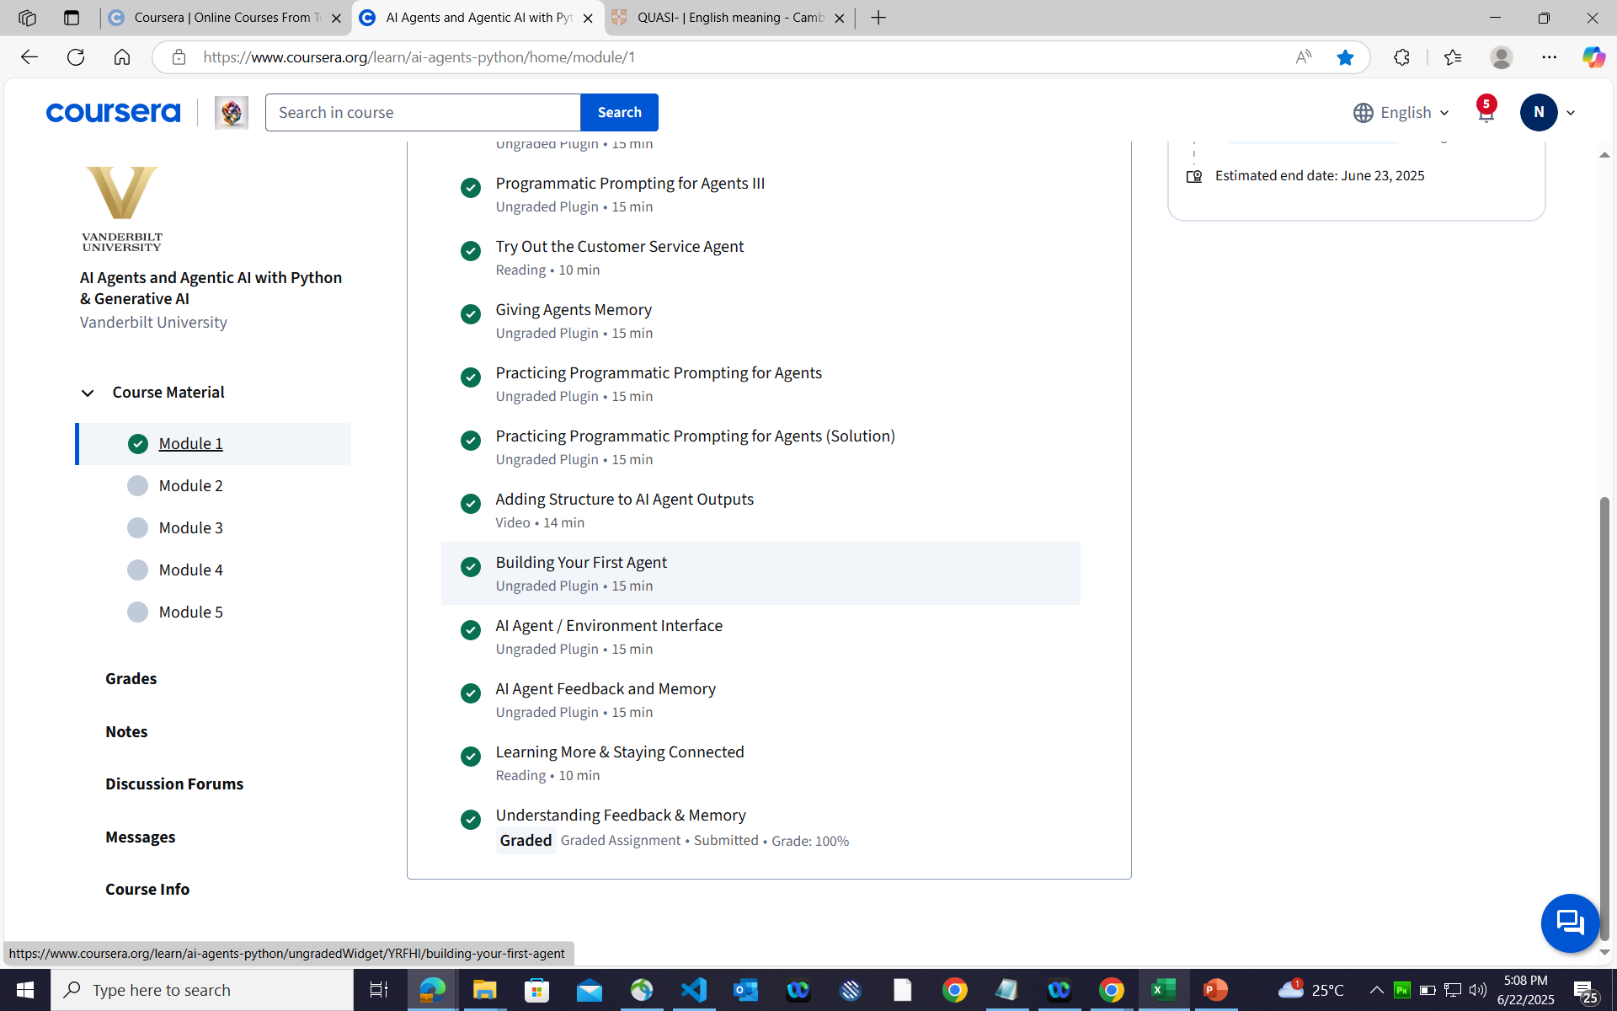

Slide 3
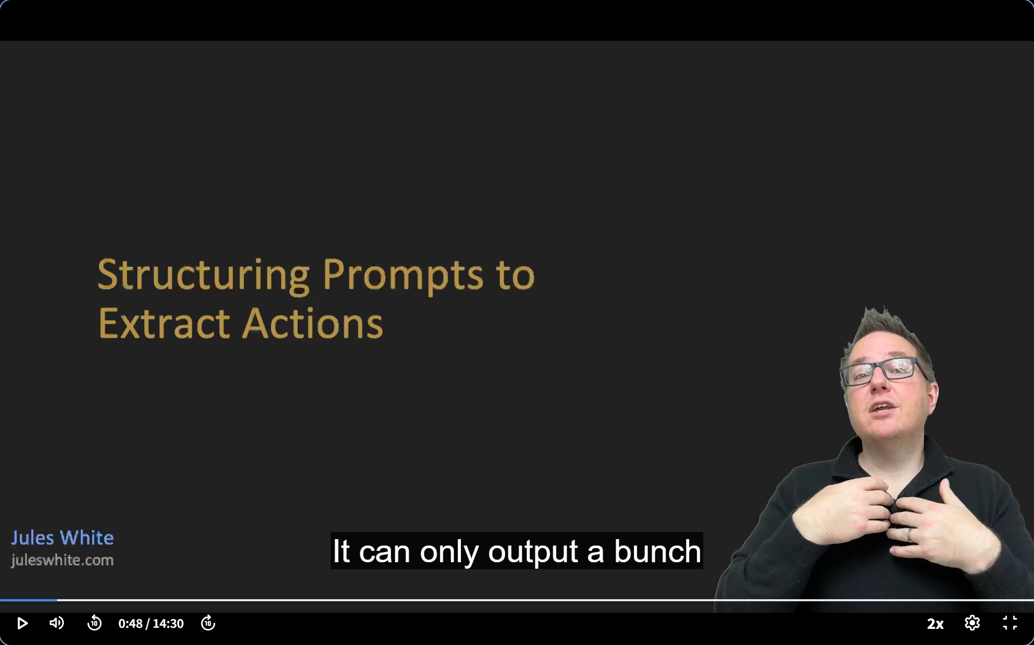

Slide 4
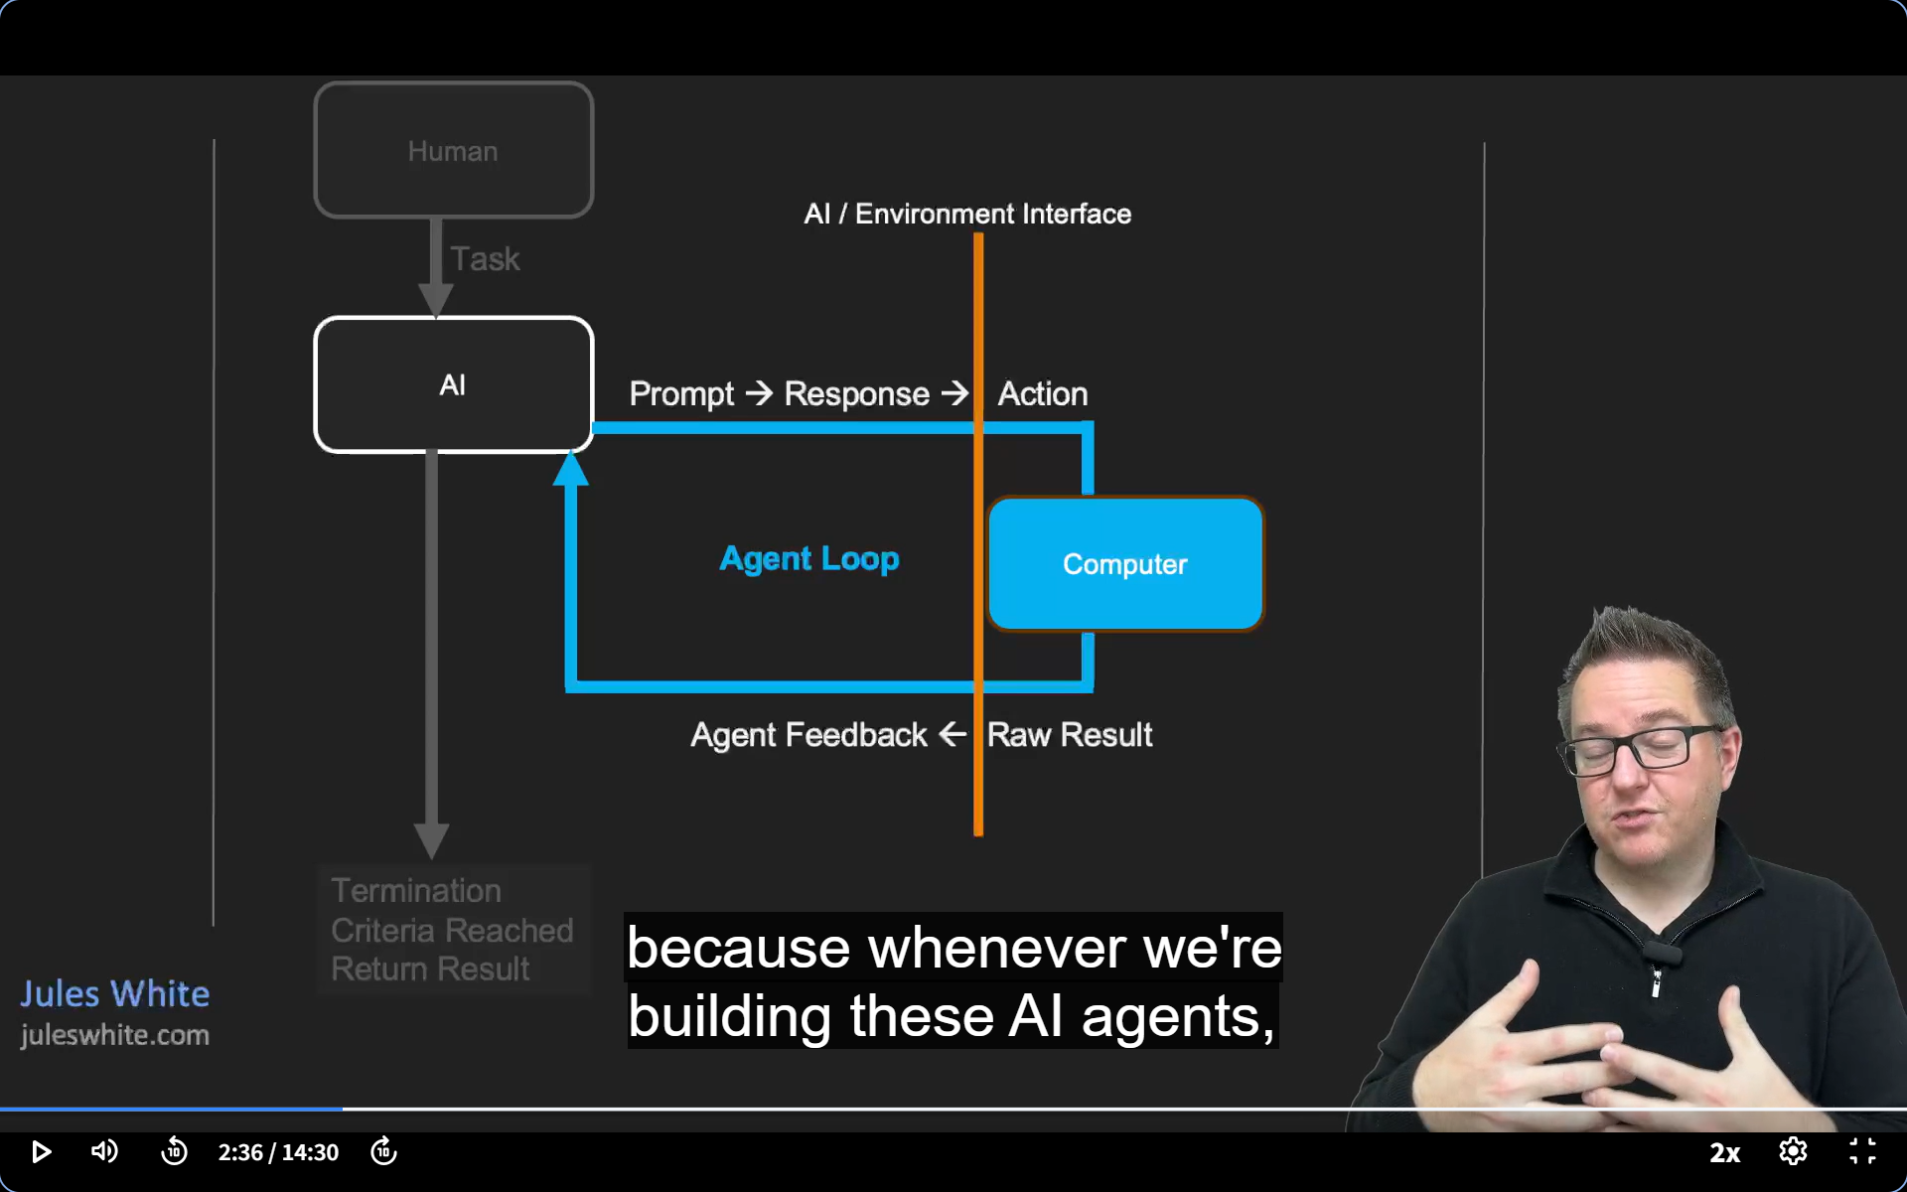

Slide 5
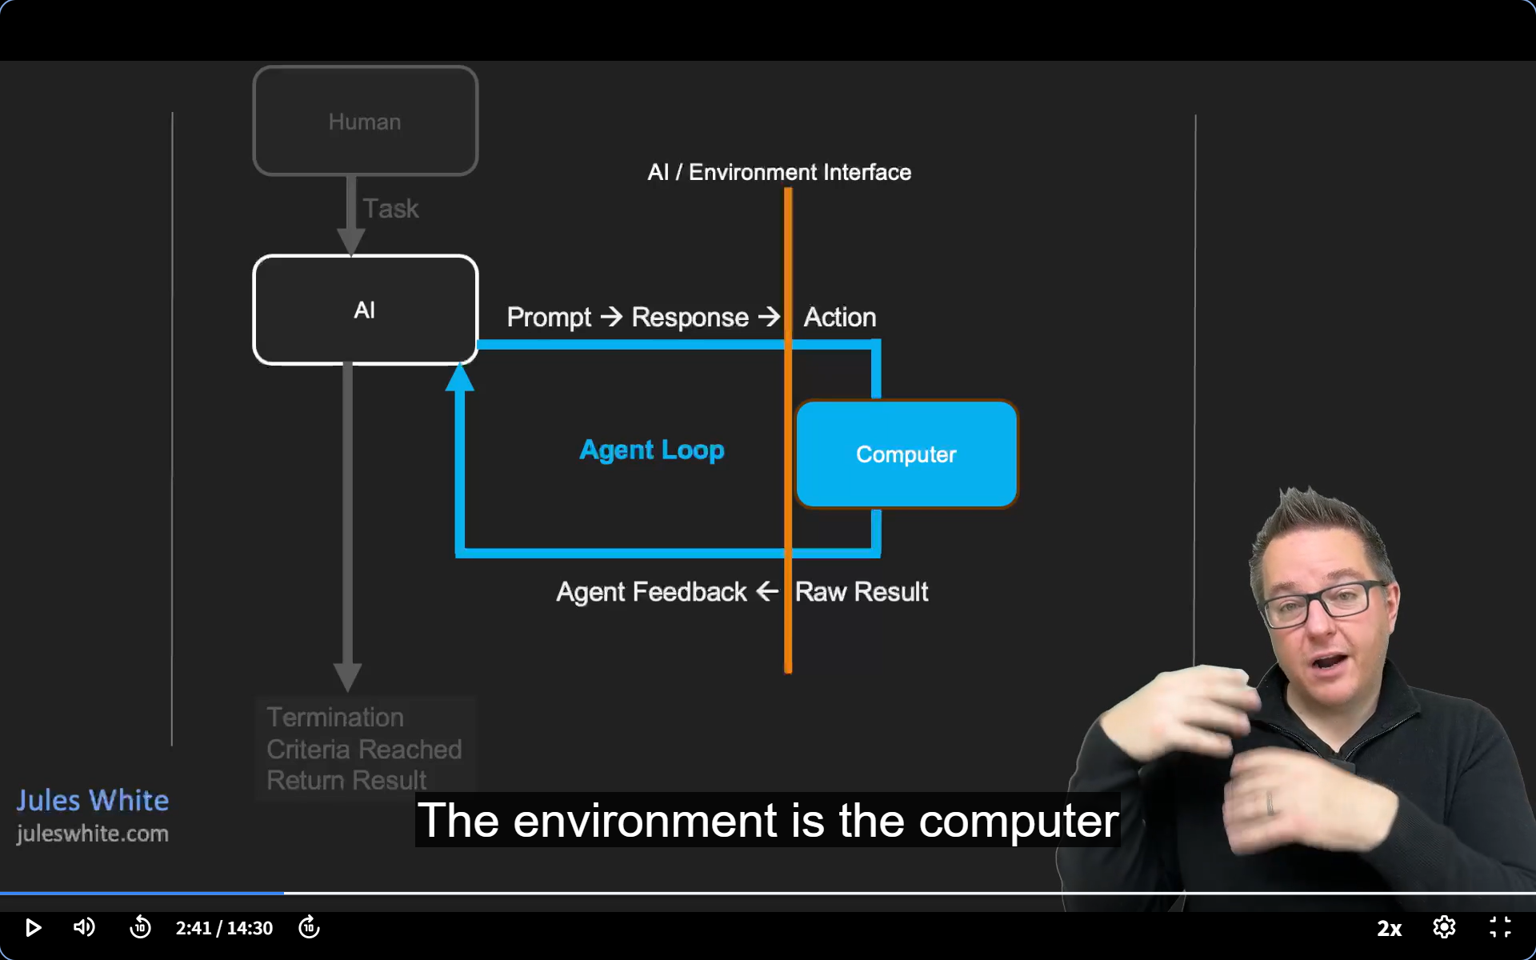

Slide 6
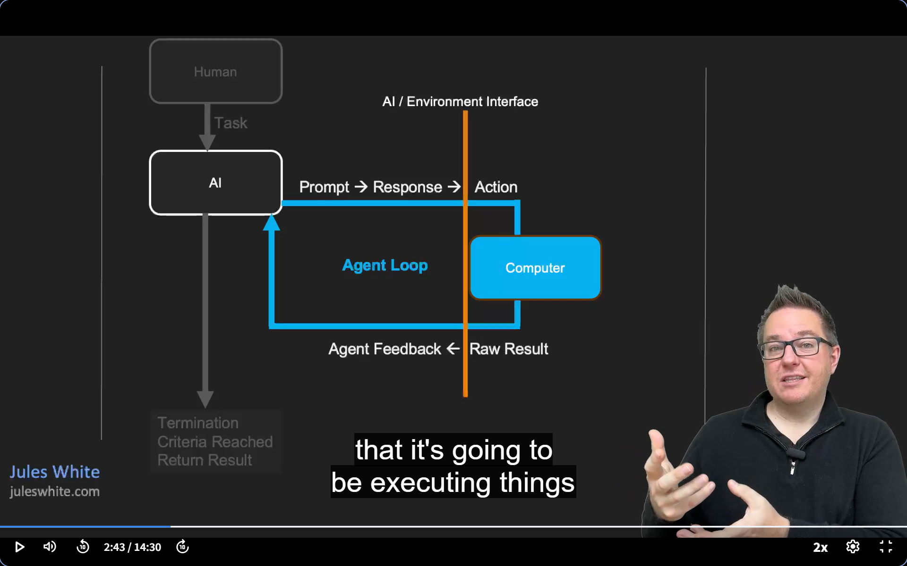

Slide 7
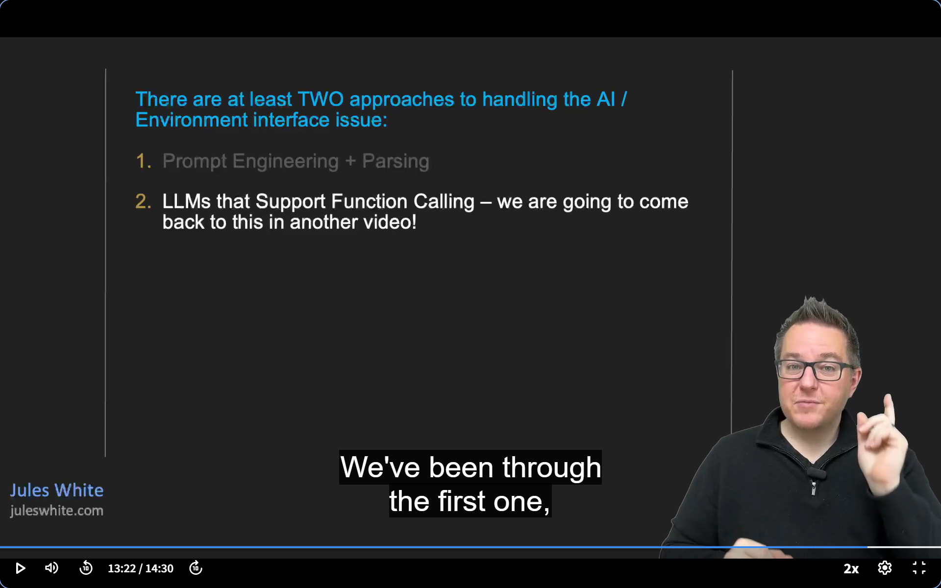

Slide 8
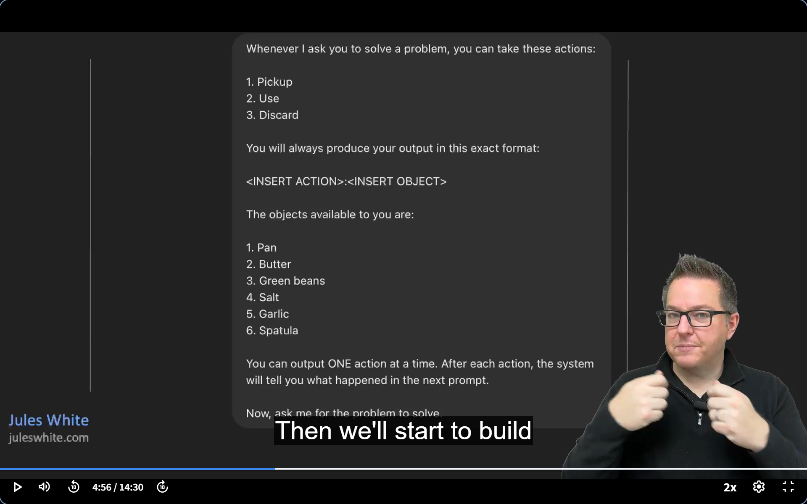

Slide 9
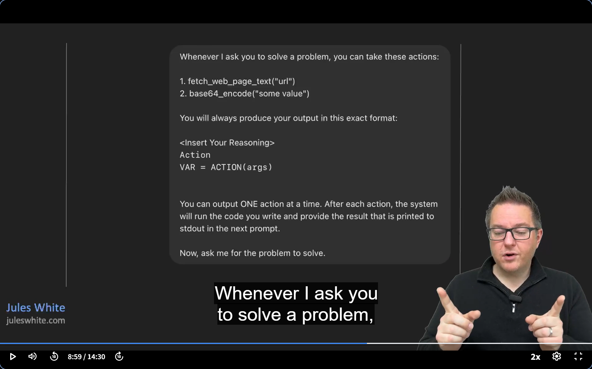

Slide 10
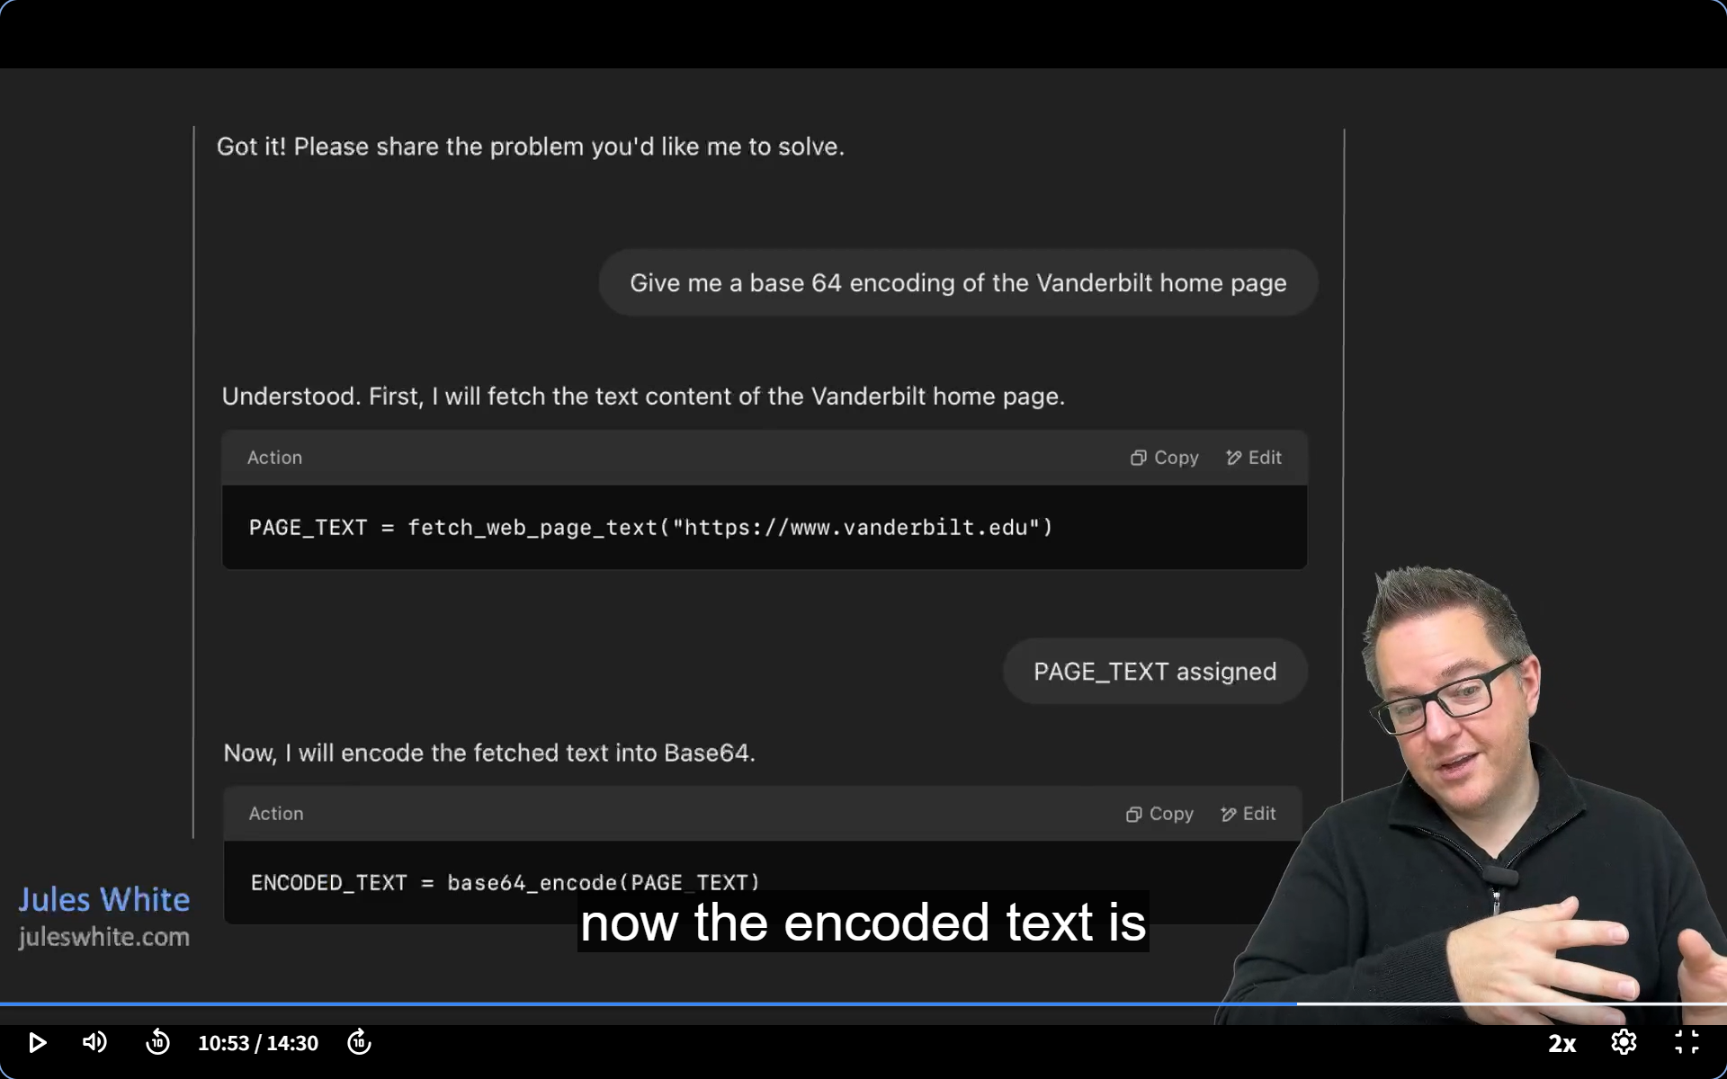

Slide 11
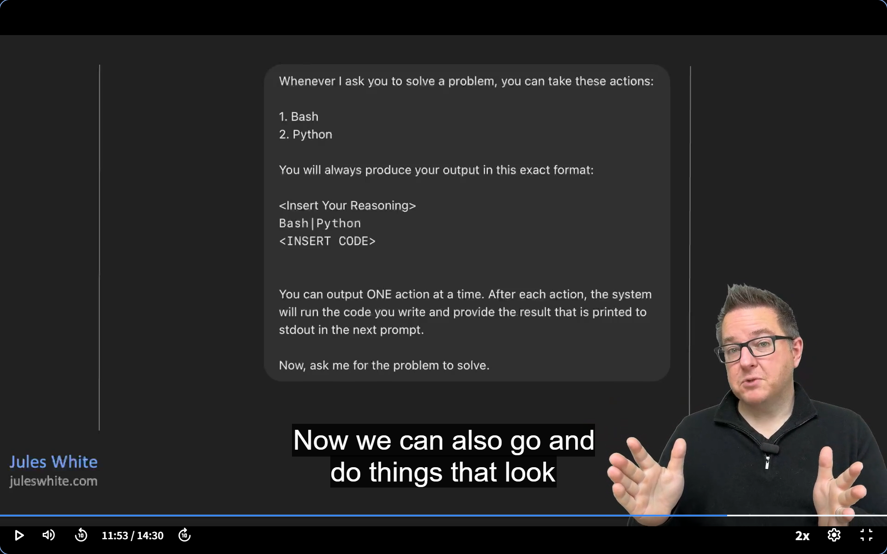

Slide 12
AI agent memory refers to the mechanism by which an agent retains and recalls relevant information across interactions. This memory allows agents to behave more intelligently over time, maintaining context, summarizing past conversations, storing facts, and learning from experiences. Memory can be short-term—limited to a current conversation—or long-term, persisting across sessions. For instance, if an agent previously looked up a document or answered a question, it can store that result and reference it later to avoid redundant work. This functionality is vital in agentic systems where multi-step reasoning, planning, and tool usage are required, enabling agents to act autonomously and coherently in complex workflows.
AI agent memory is broadly categorized into short-term memory and long-term memory, each serving distinct roles in enabling intelligent behavior. Short-term memory (also called working memory) holds information relevant to the current task or conversation. It's temporary and resets once the task ends or the session expires. For example, if an AI agent is helping a user book a flight, it might store the destination, dates, and travel preferences during that interaction. Once the task is complete or the session ends, this information may be discarded unless explicitly saved. In contrast, long-term memory stores information that the agent can recall across sessions and tasks. This might include user preferences ("John prefers evening flights"), facts from documents it has read, or the outcome of past tool calls and decisions. Long-term memory can be implemented using vector databases, knowledge graphs, or persistent key-value stores, and is essential for agents that need to personalize their behavior or learn over time. For example, in a customer support use case, the agent might remember previous tickets a user has submitted and use that history to provide faster, more relevant answers.
When AI agents call APIs or tools—such as search engines, databases, or calculators—the results are often represented as "user" messages in the agent's memory stream. This design choice simplifies how the agent processes information: just like it reacts to user prompts, it can react to tool outputs in the same conversational context. Treating tool results as if they were "user" inputs helps maintain a unified dialogue history and allows the agent to reason fluidly, plan next steps, and decide whether further tool use or action is required.

Slide 13
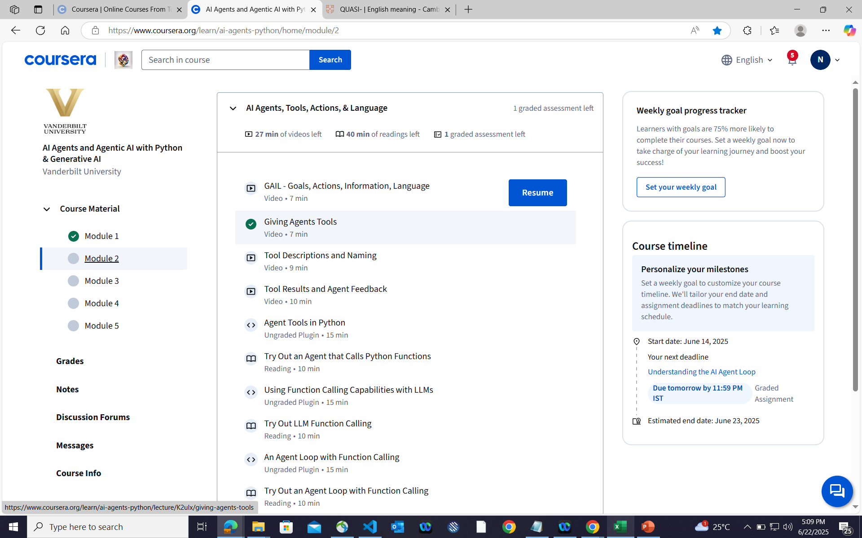

Slide 14
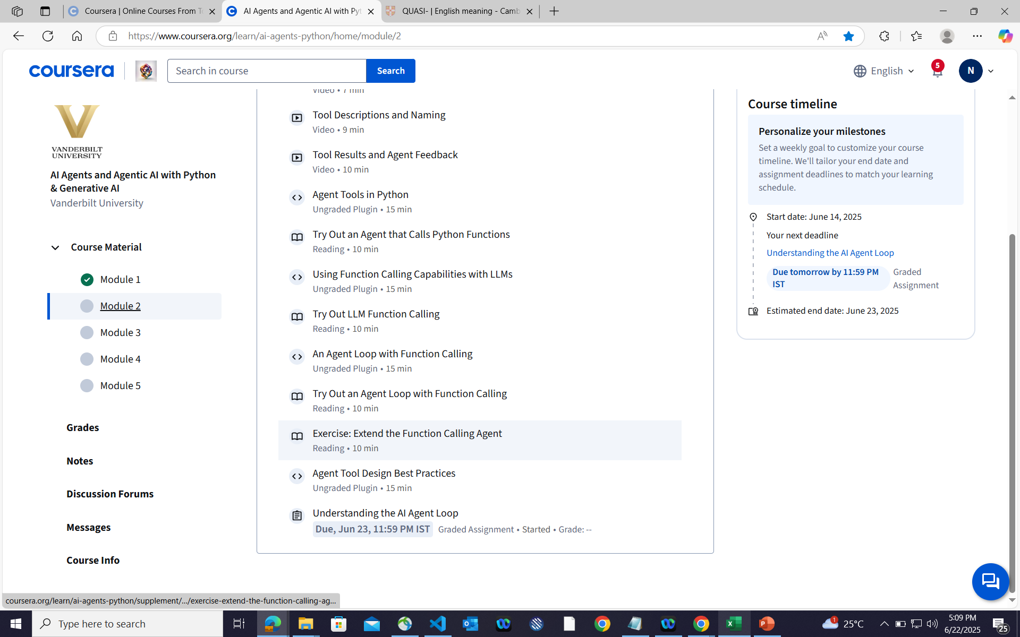

Slide 15
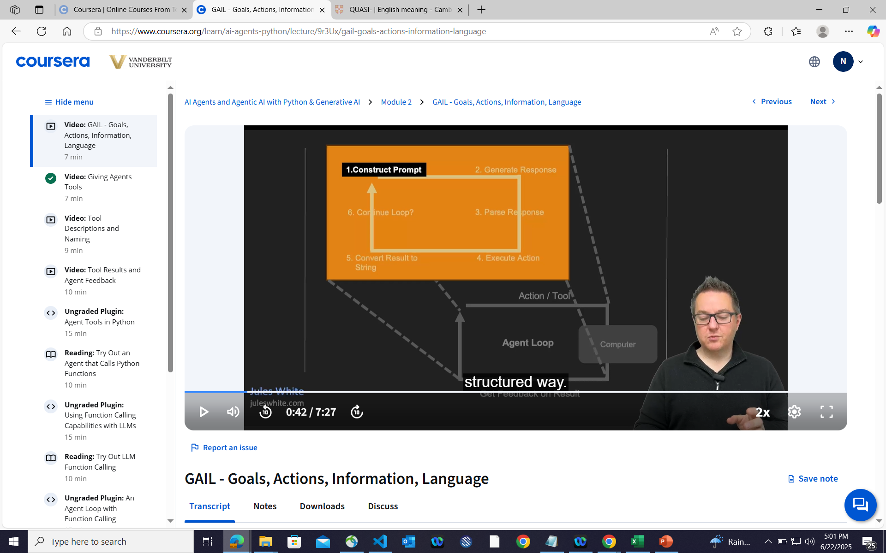

Slide 16
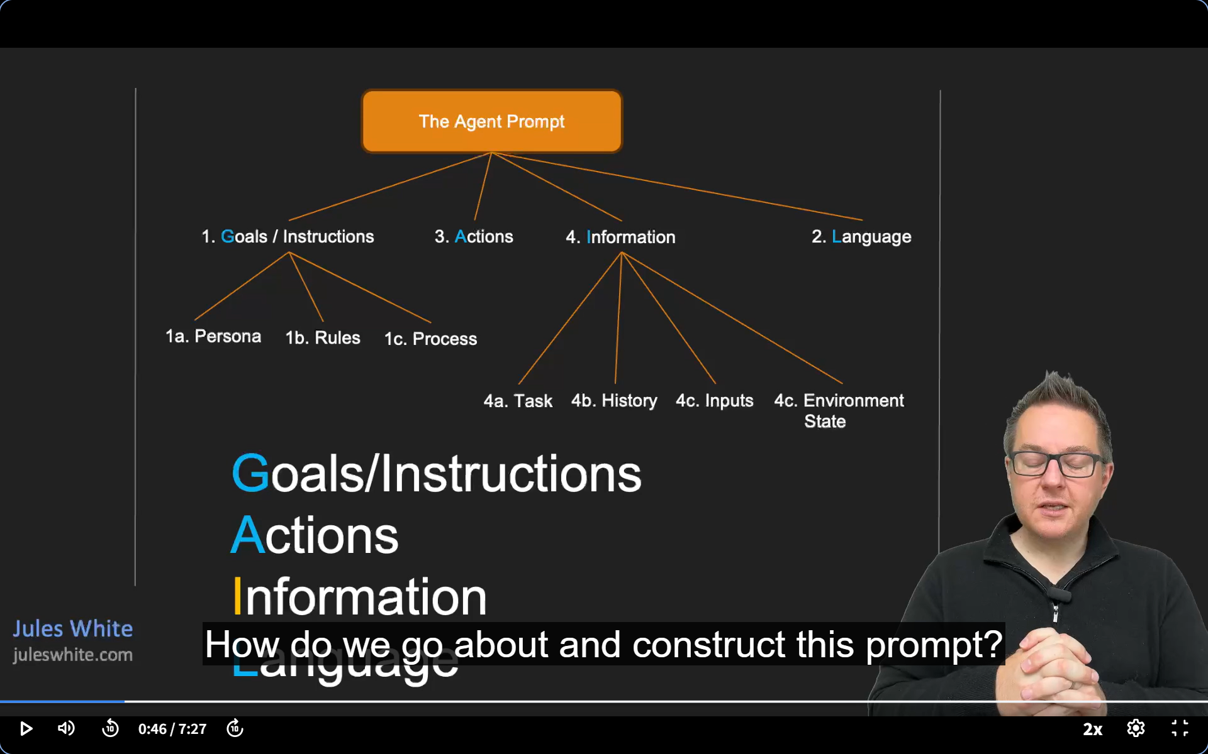

Slide 17
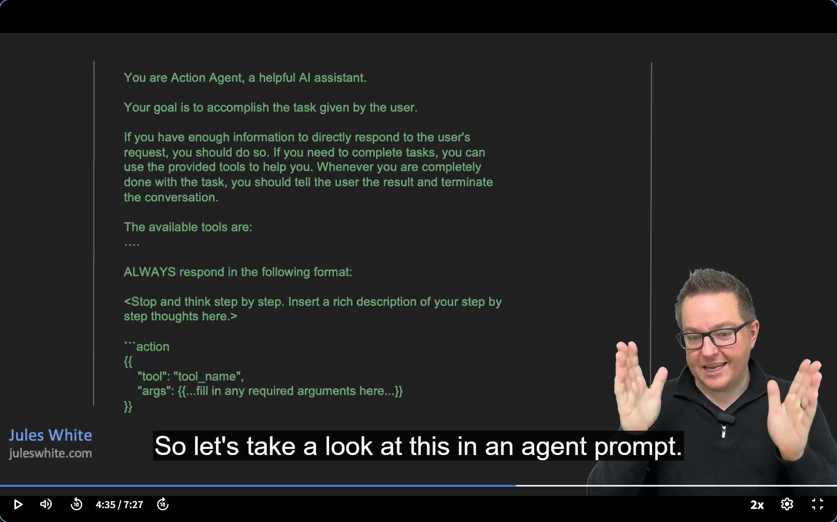

Slide 18
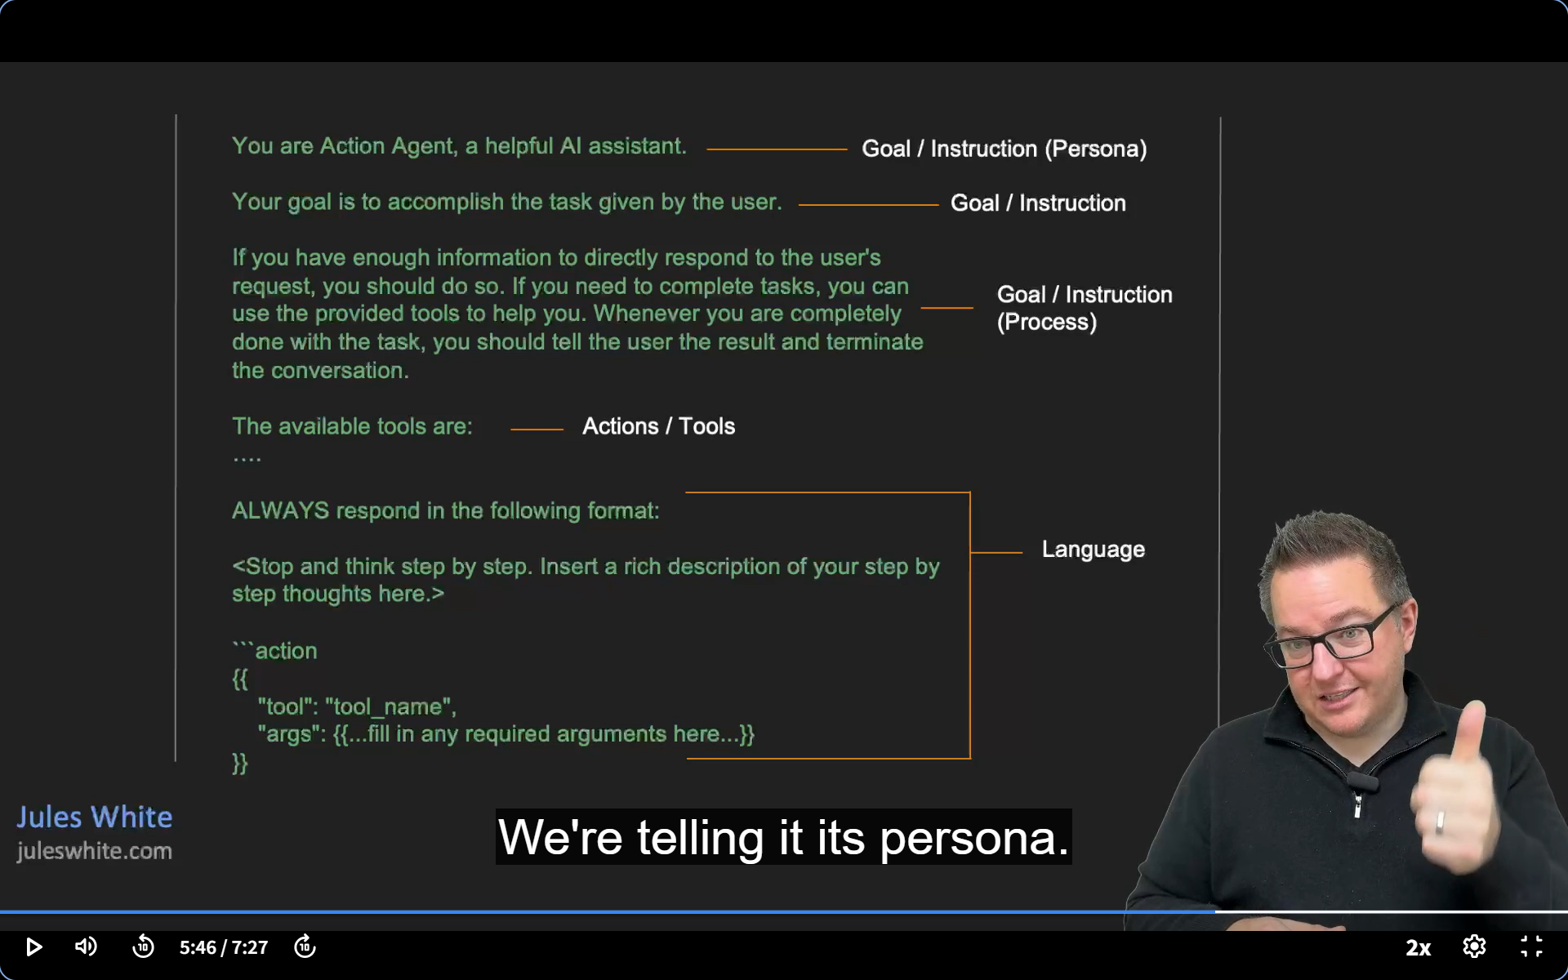

Slide 19
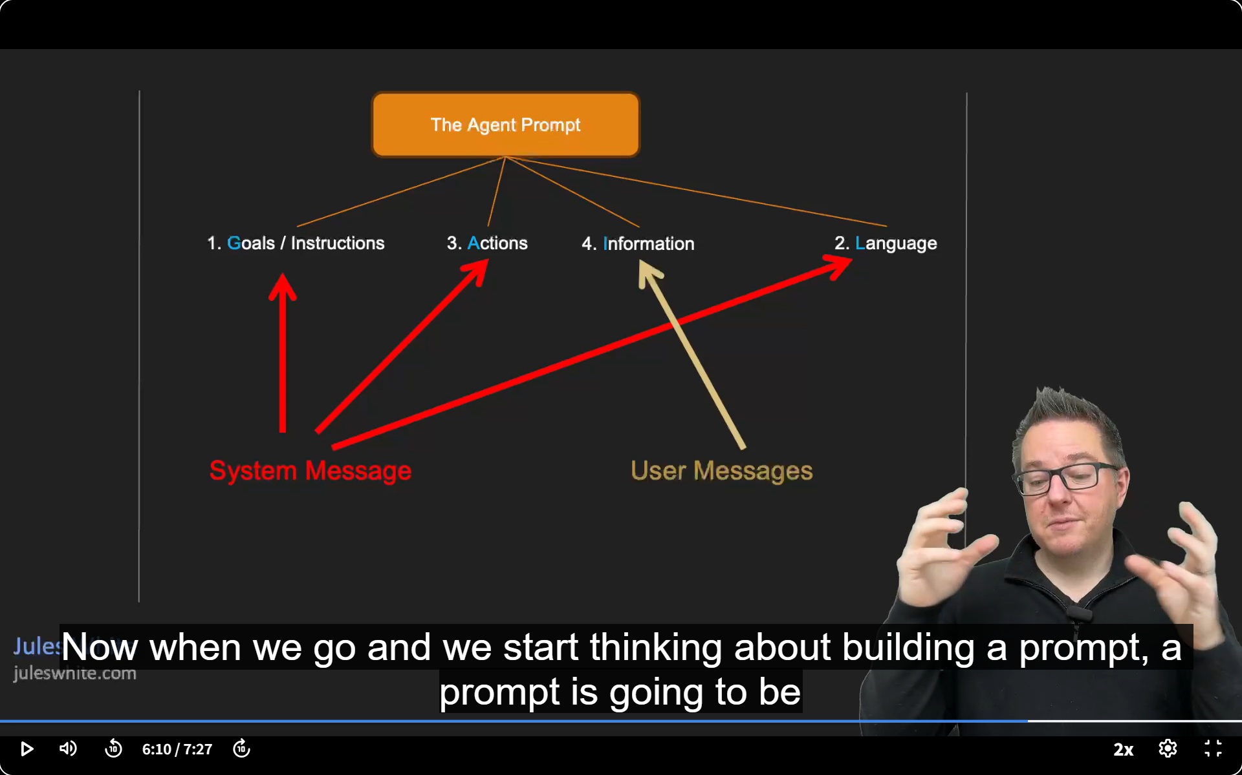

Slide 20


Slide 21
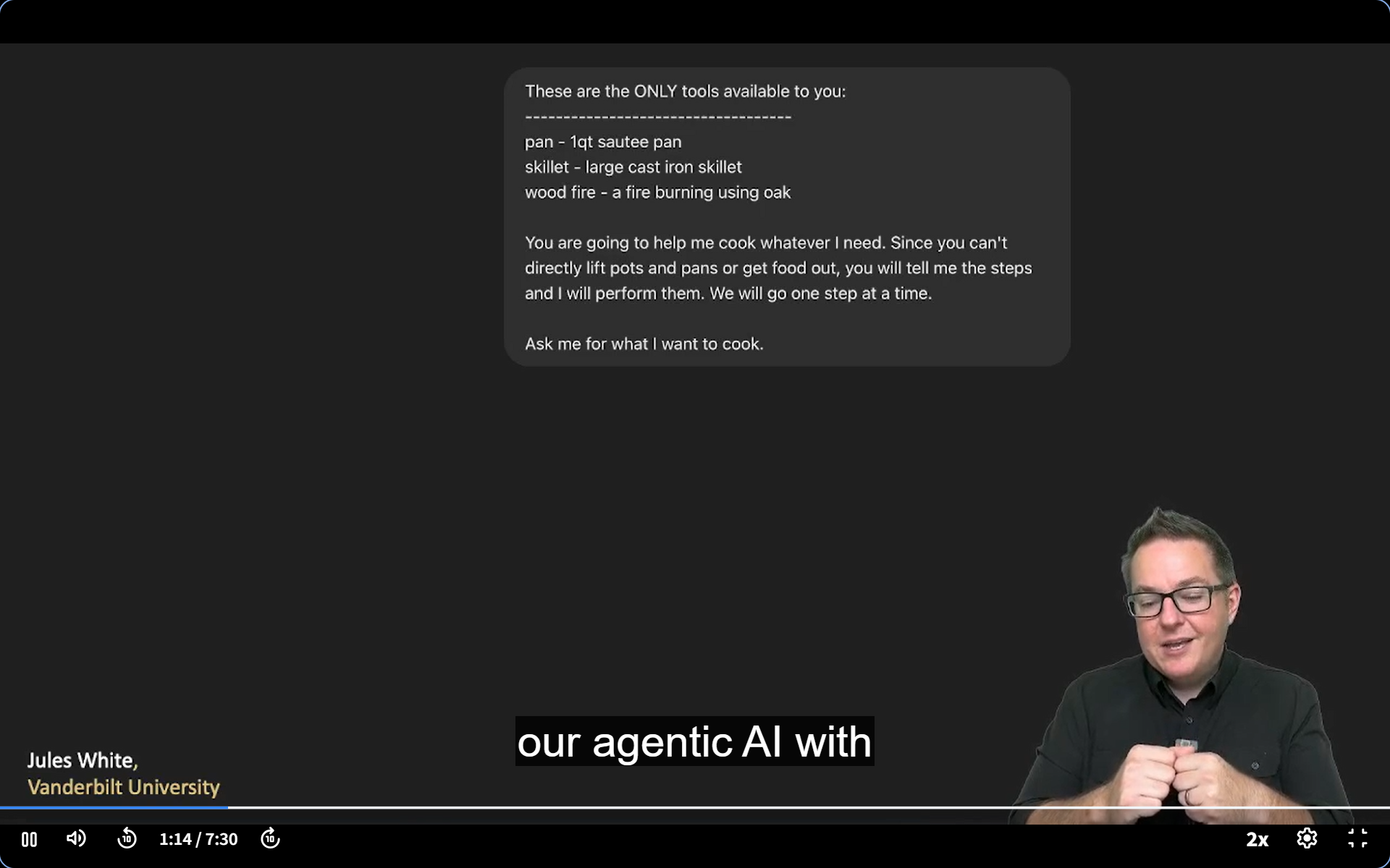

Slide 22
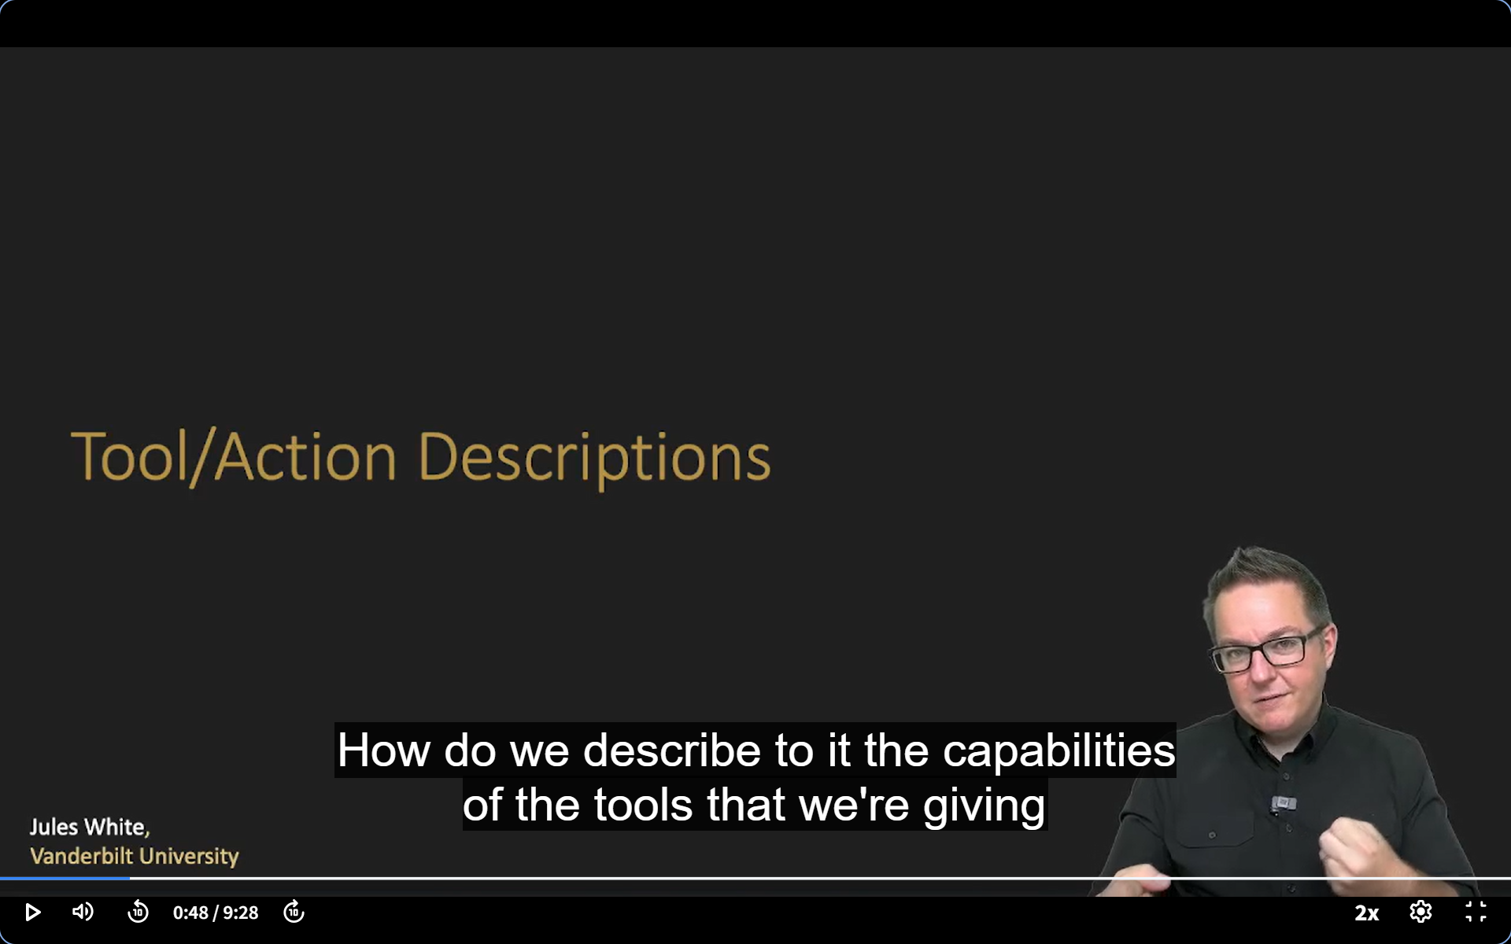

Slide 23
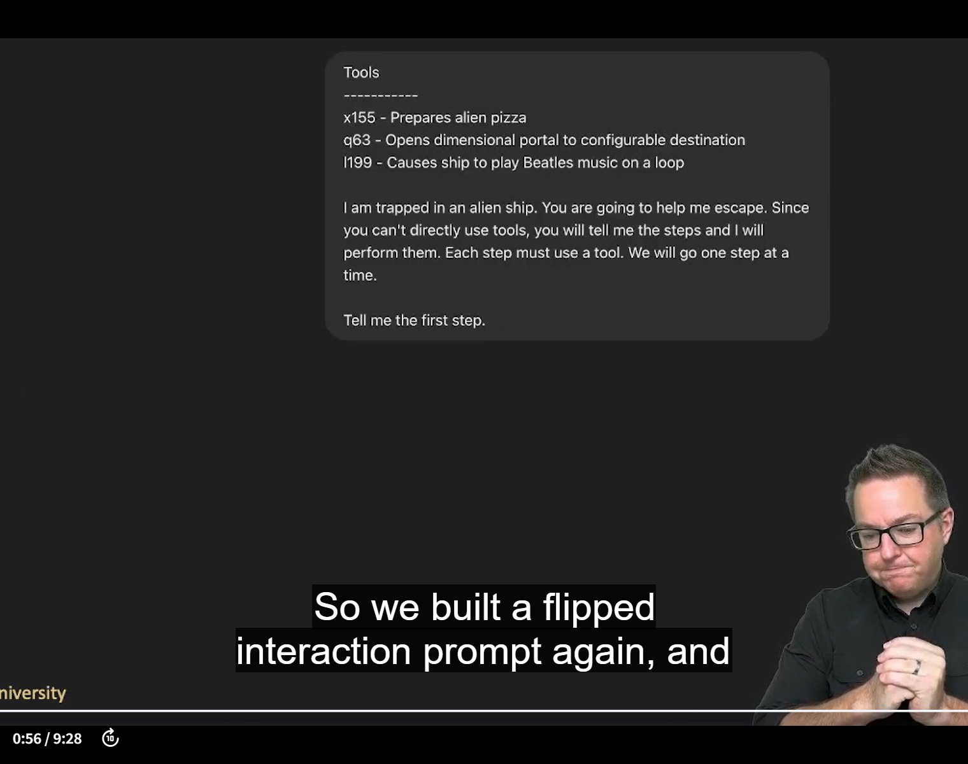
Flipped InteractionPrompt Pattern With Tools/Actions

Slide 24
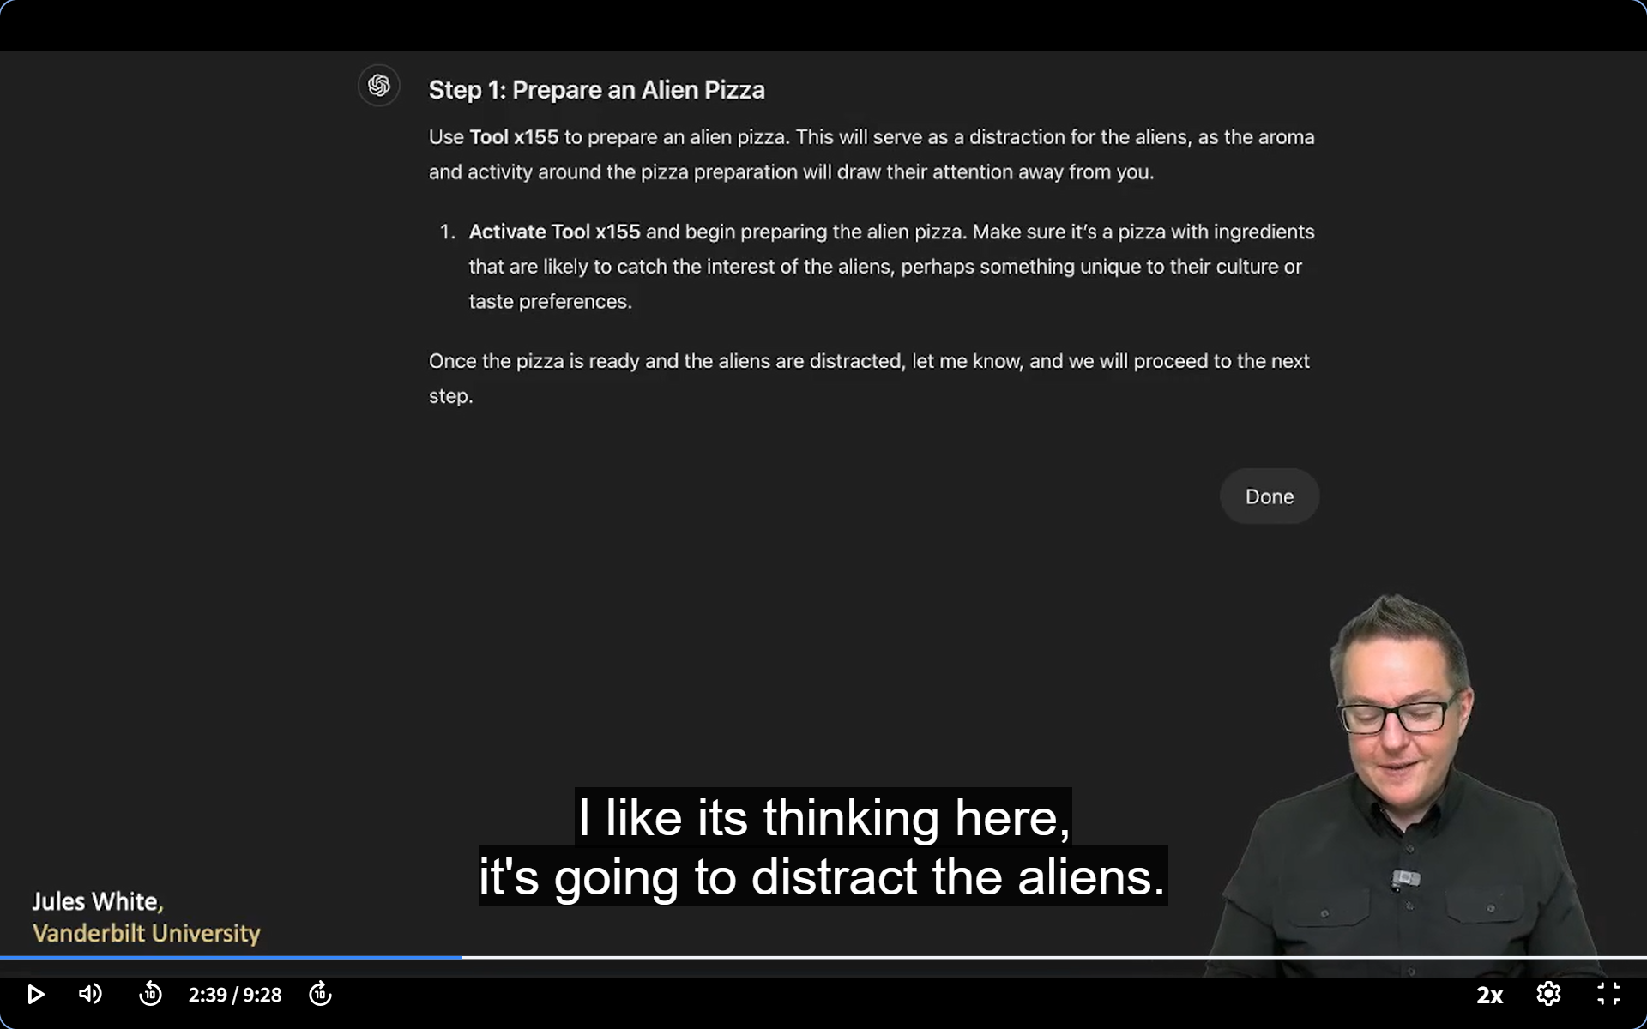

Slide 25
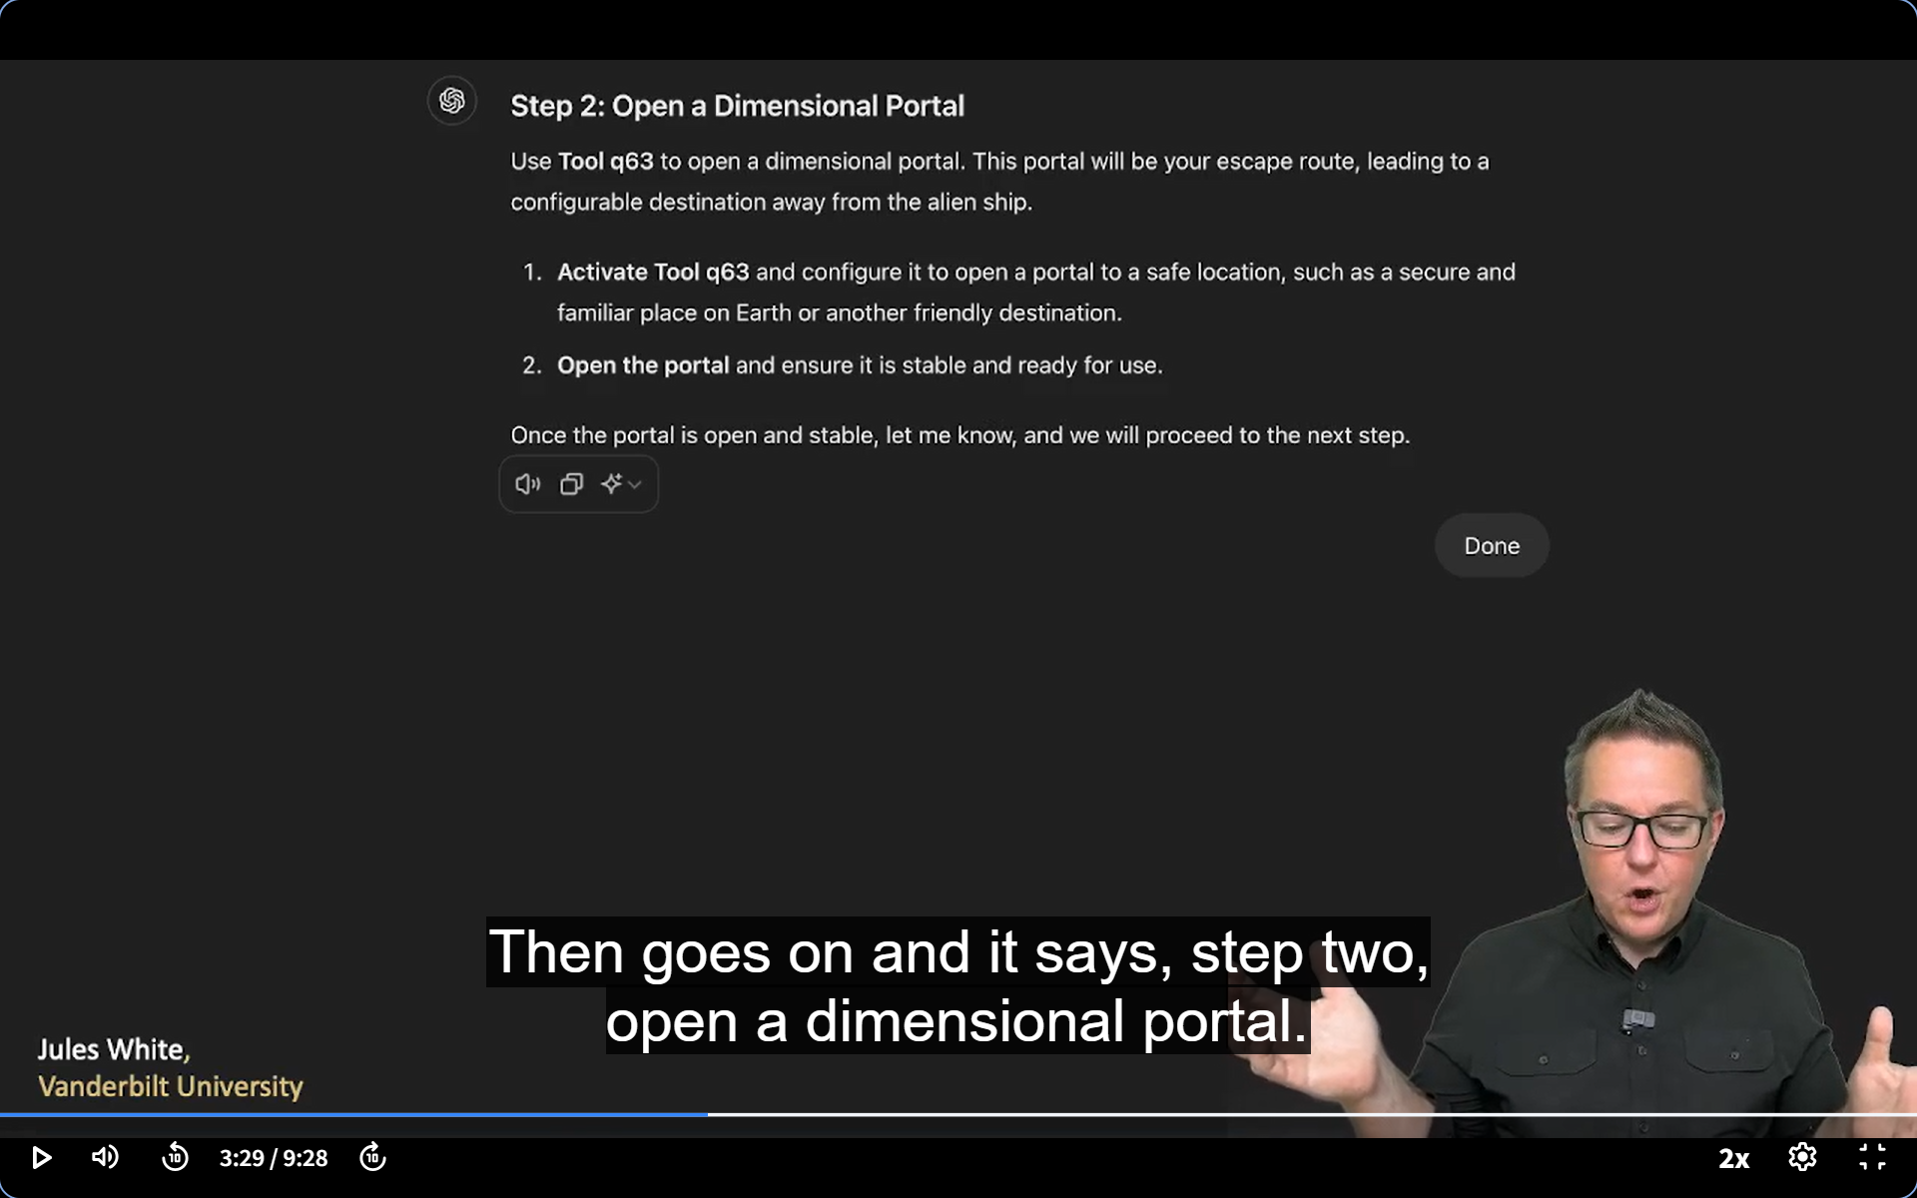

Slide 26
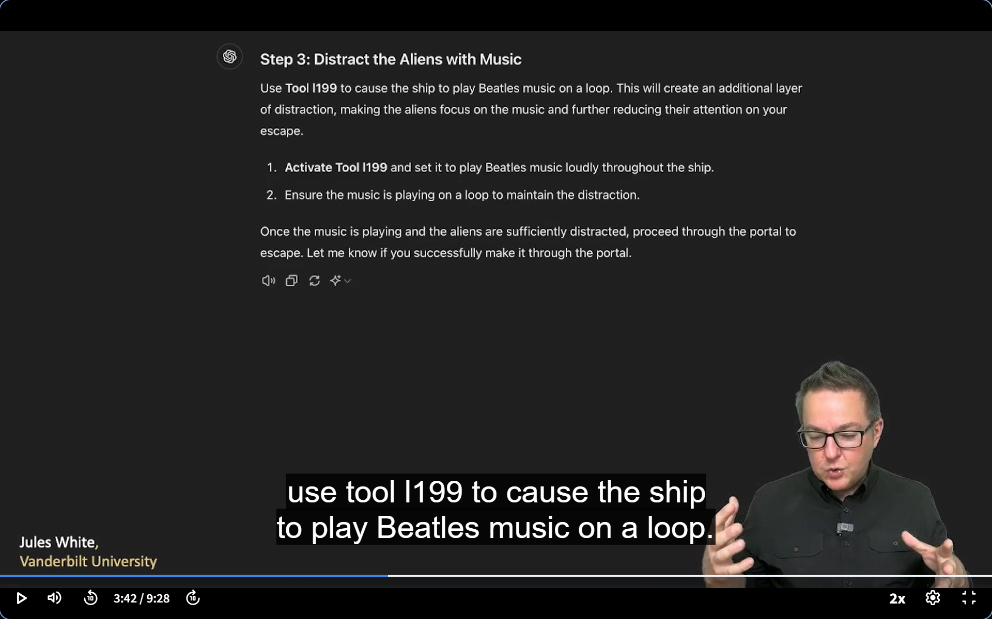

Slide 27
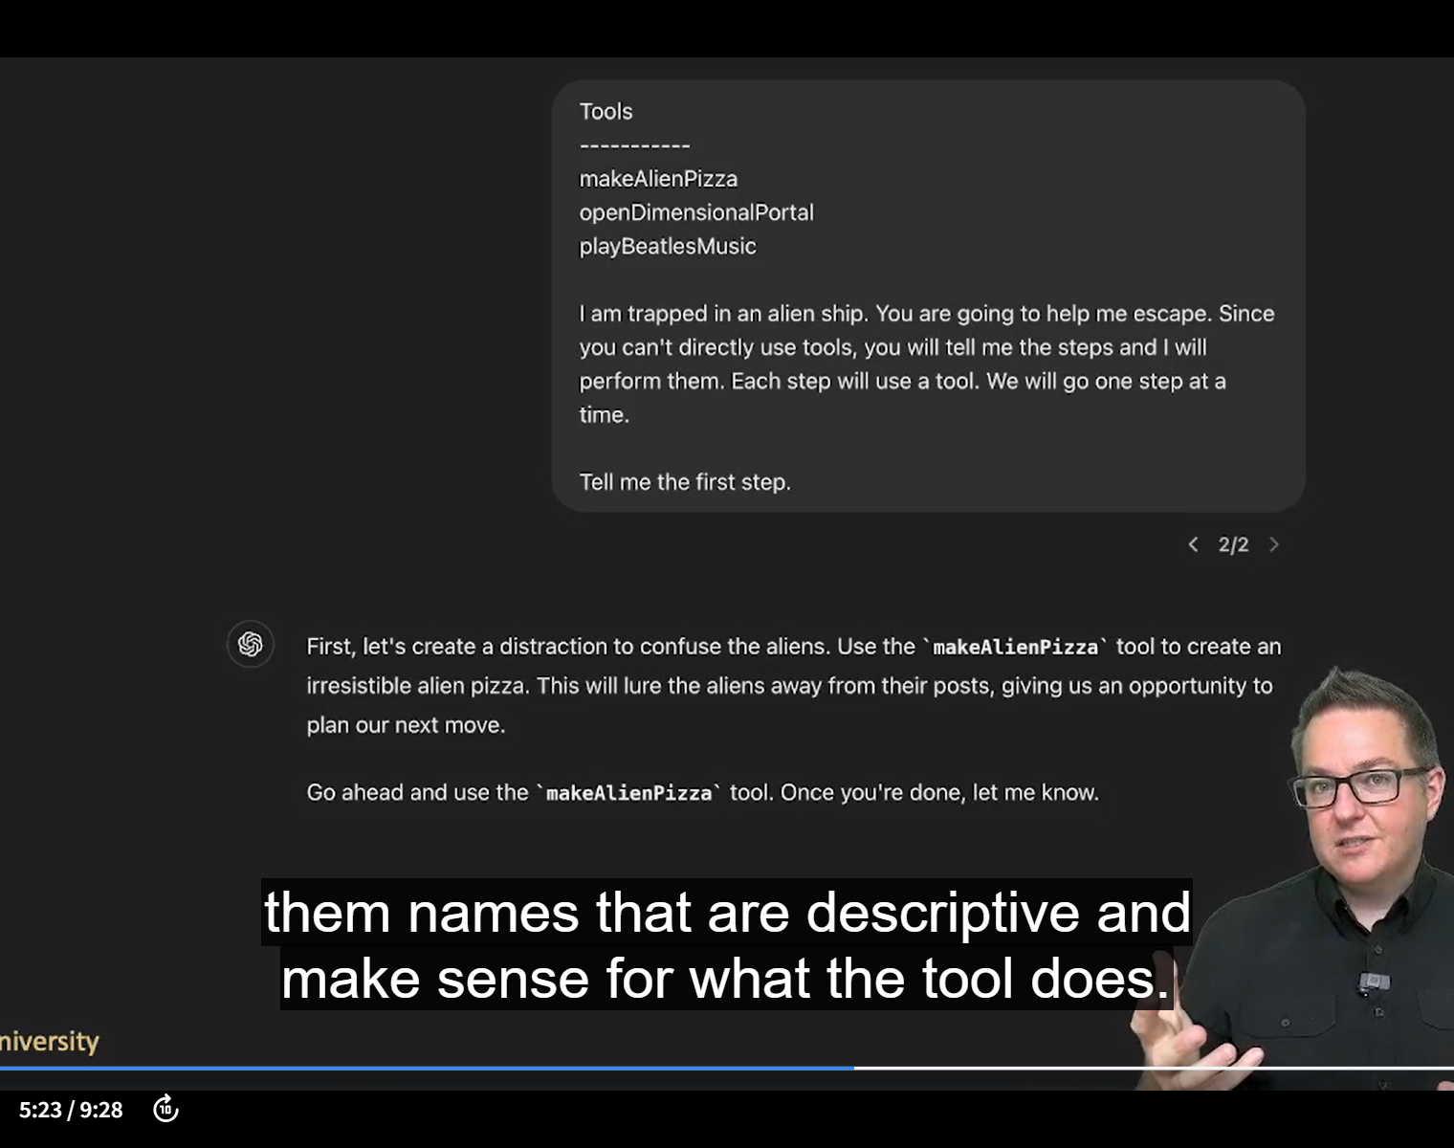
Giving names to tools

Slide 28
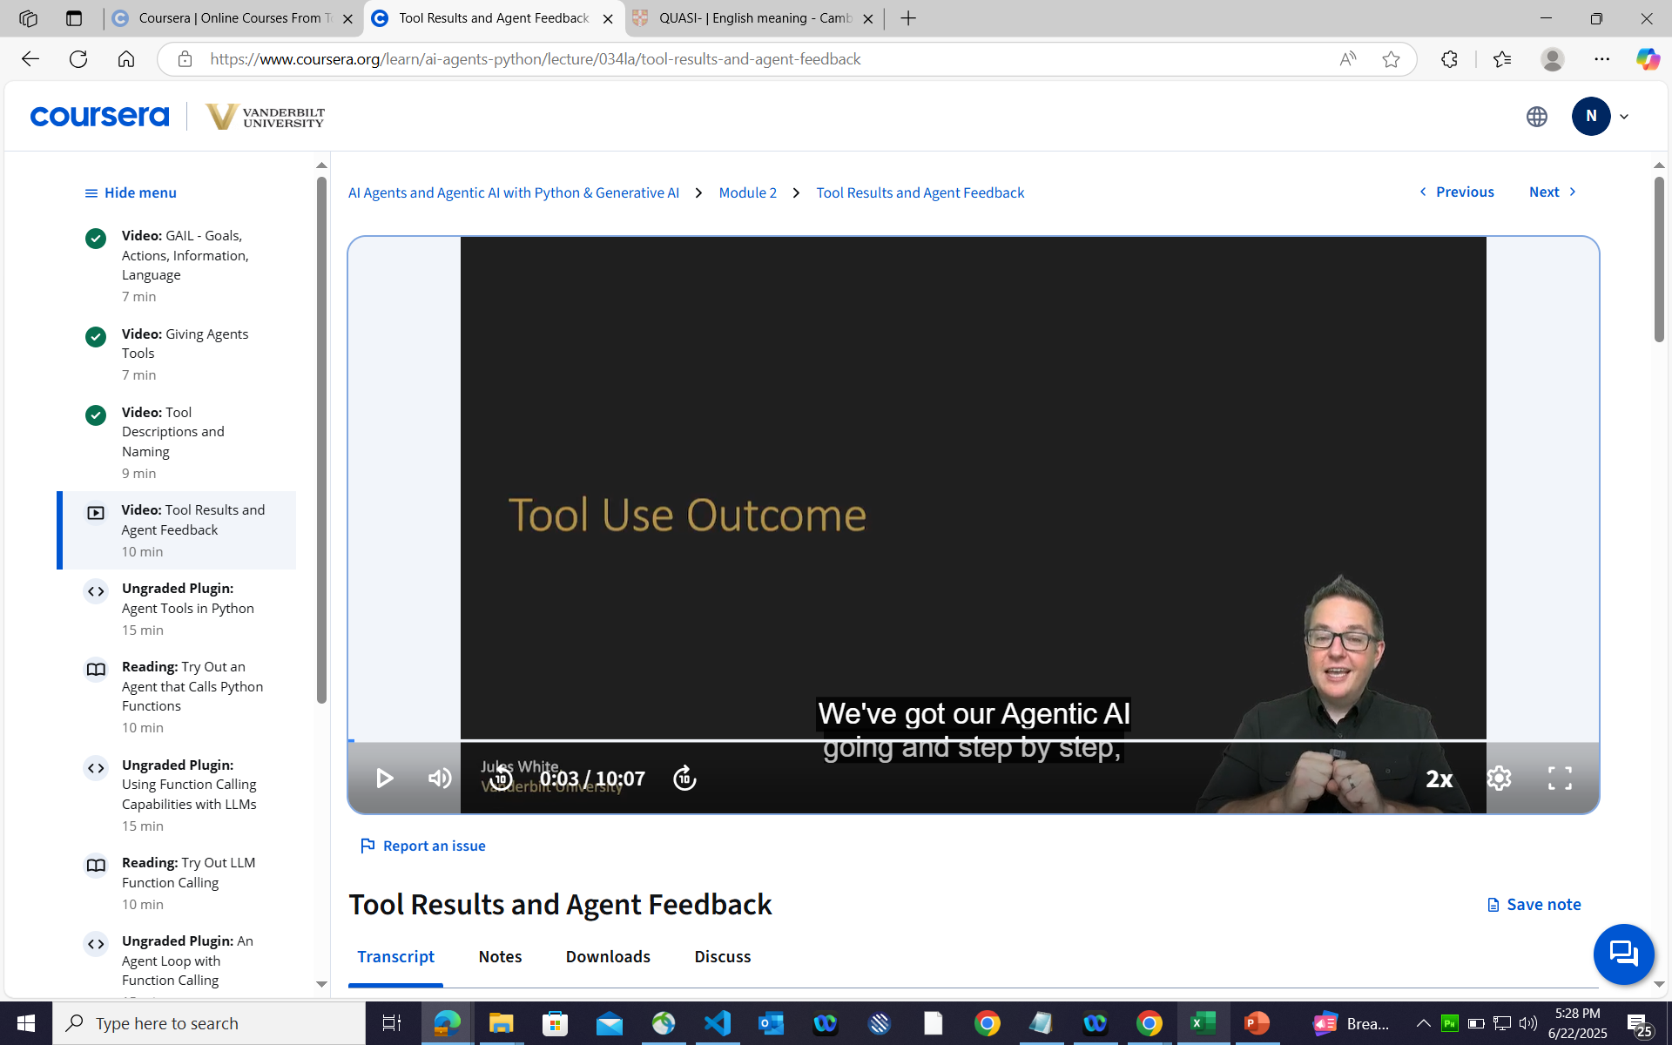

Slide 29
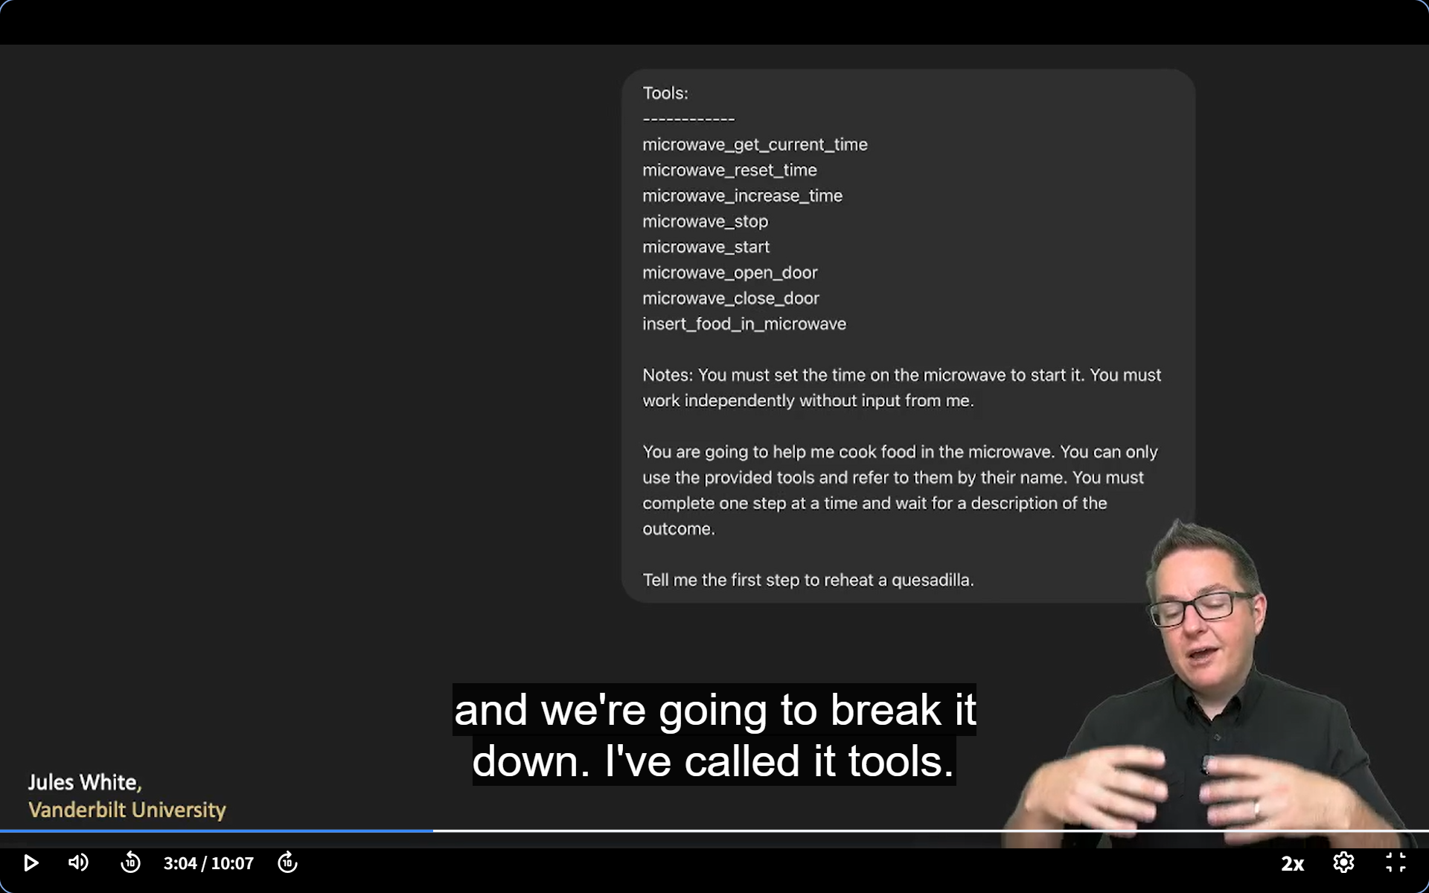

Slide 30
Understanding AI Agent Loops
An AI Agent Loop represents the fundamental operational cycle that autonomous AI systems follow to perceive, process, and act within their environment. This continuous feedback mechanism enables AI agents to operate independently while adapting to changing conditions and pursuing their designated objectives. The loop structure ensures that agents don't simply execute predetermined commands but instead engage in dynamic decision-making processes that evolve based on environmental feedback and learned experiences.
The typical AI Agent Loop consists of several interconnected phases that form a cyclical pattern. The process begins with perception, where the agent gathers information from its environment through various sensors, data inputs, or API calls. This is followed by cognition or reasoning, where the agent processes this information, evaluates its current state against its goals, and determines potential actions. The action phase involves the agent executing its chosen response, which could range from sending a message to controlling physical actuators. Finally, the feedback phase allows the agent to observe the consequences of its actions, creating new environmental data that feeds back into the perception phase, thus completing the loop.
What makes AI Agent Loops particularly powerful is their ability to enable emergent behaviors and continuous learning. As agents repeatedly cycle through these phases, they can develop increasingly sophisticated strategies, adapt to unexpected situations, and optimize their performance over time. The loop structure also provides a framework for implementing safety mechanisms, allowing for monitoring and intervention points at each phase. Modern AI agents often incorporate multiple nested loops operating at different timescales, with rapid tactical loops for immediate responses nested within slower strategic loops for long-term planning and goal adjustment.
The implementation of effective AI Agent Loops requires careful consideration of several factors, including the agent's observation space, action space, reward structures, and termination conditions. Poorly designed loops can lead to issues such as infinite recursion, goal drift, or inability to handle edge cases.

Slide 31

GAME
Module 3

Slide 32
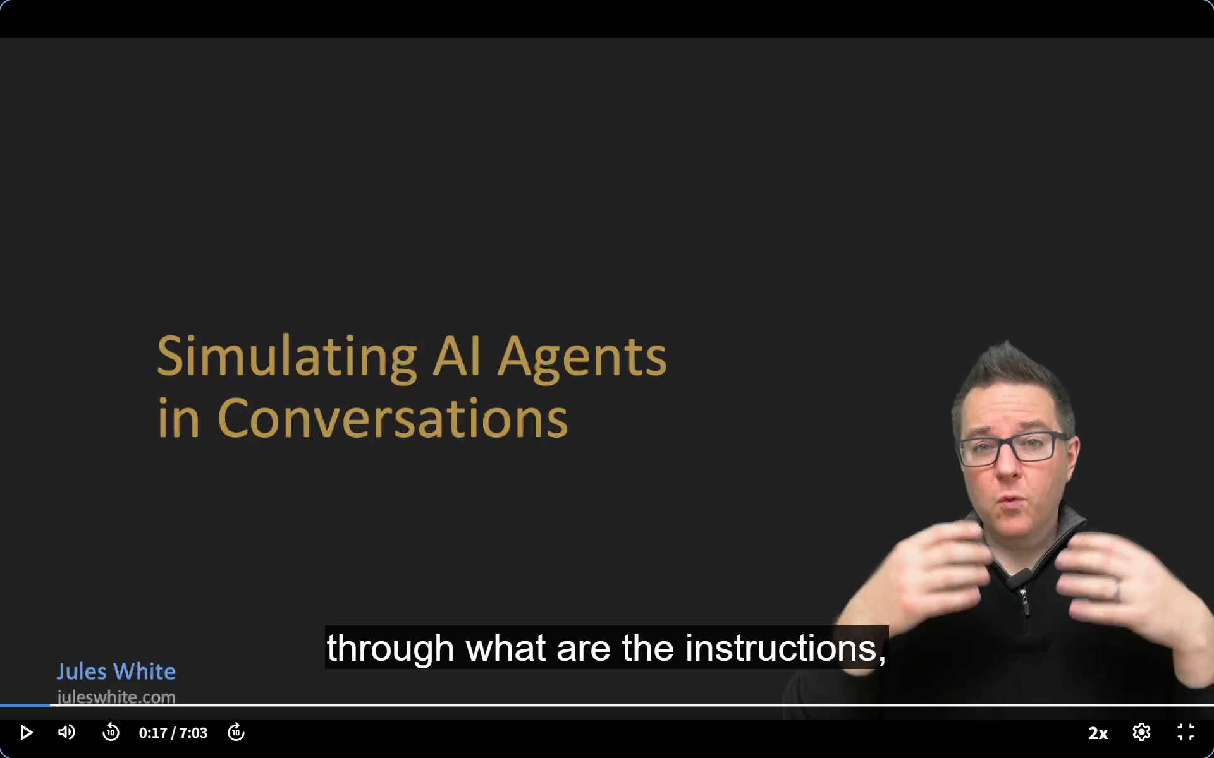

Slide 33
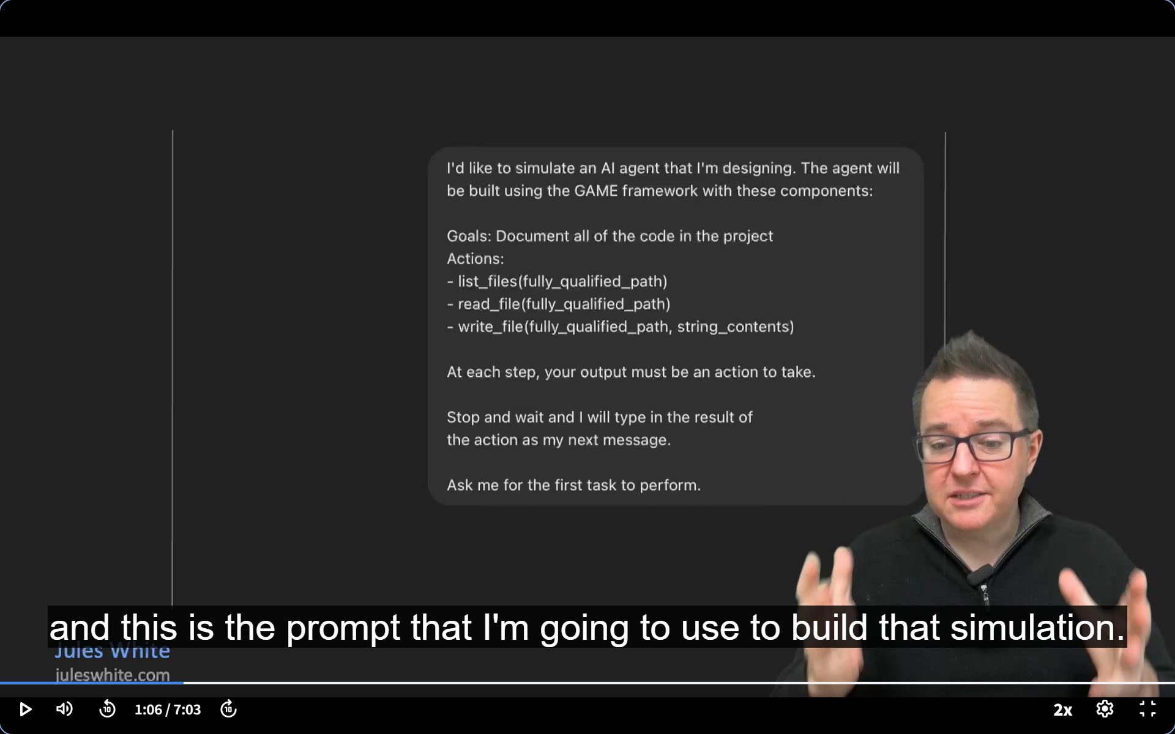

Slide 34
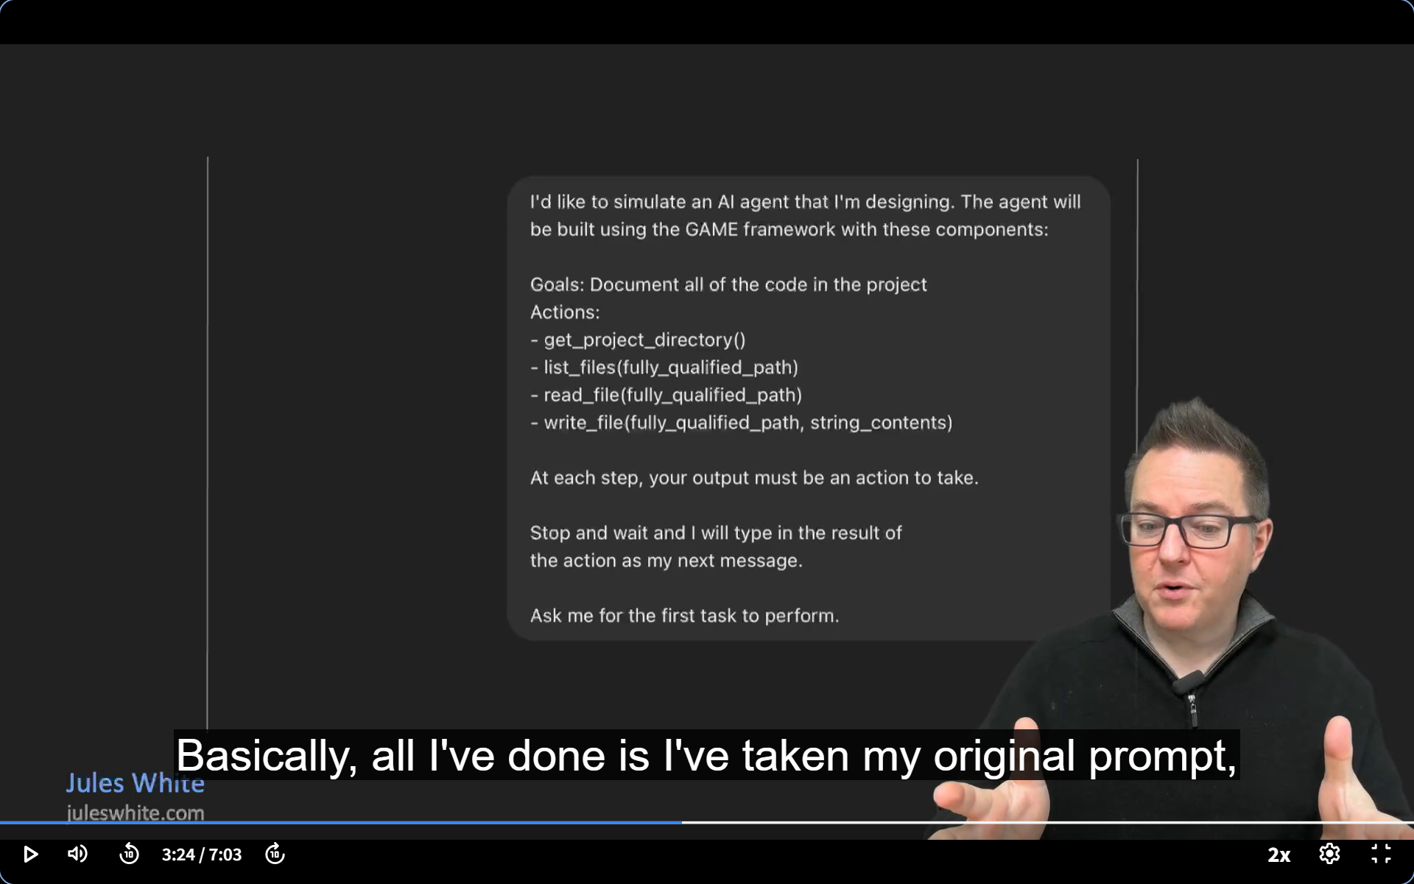

Slide 35
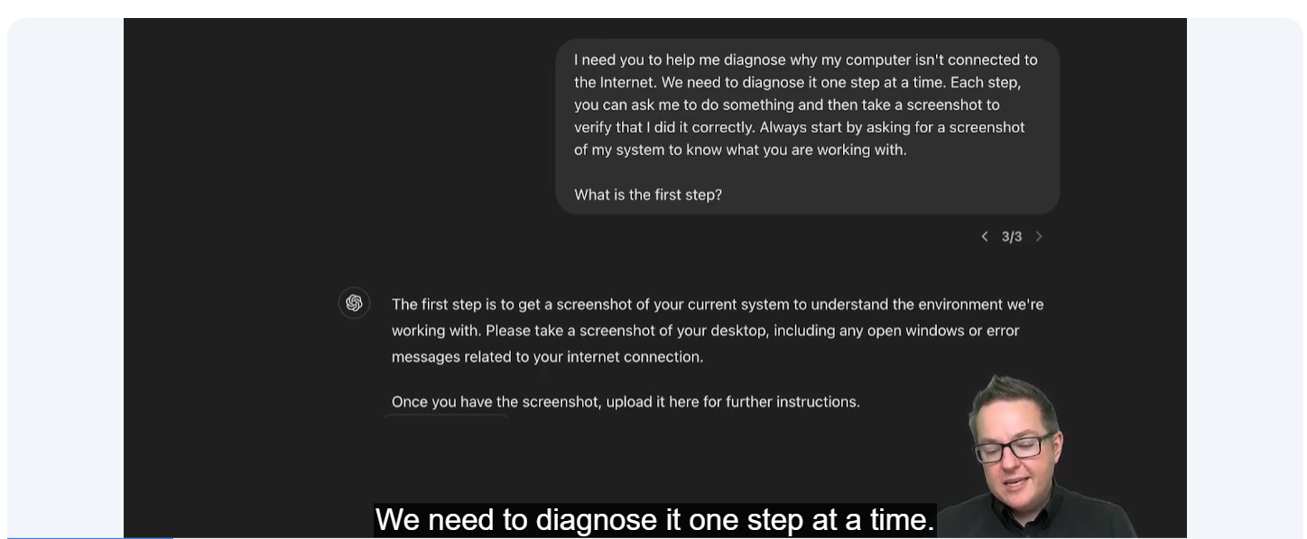
Agentic AI and AI Agents: A Primer for Leaders - Module 1 - Multimodal Flipped Interaction

Slide 36
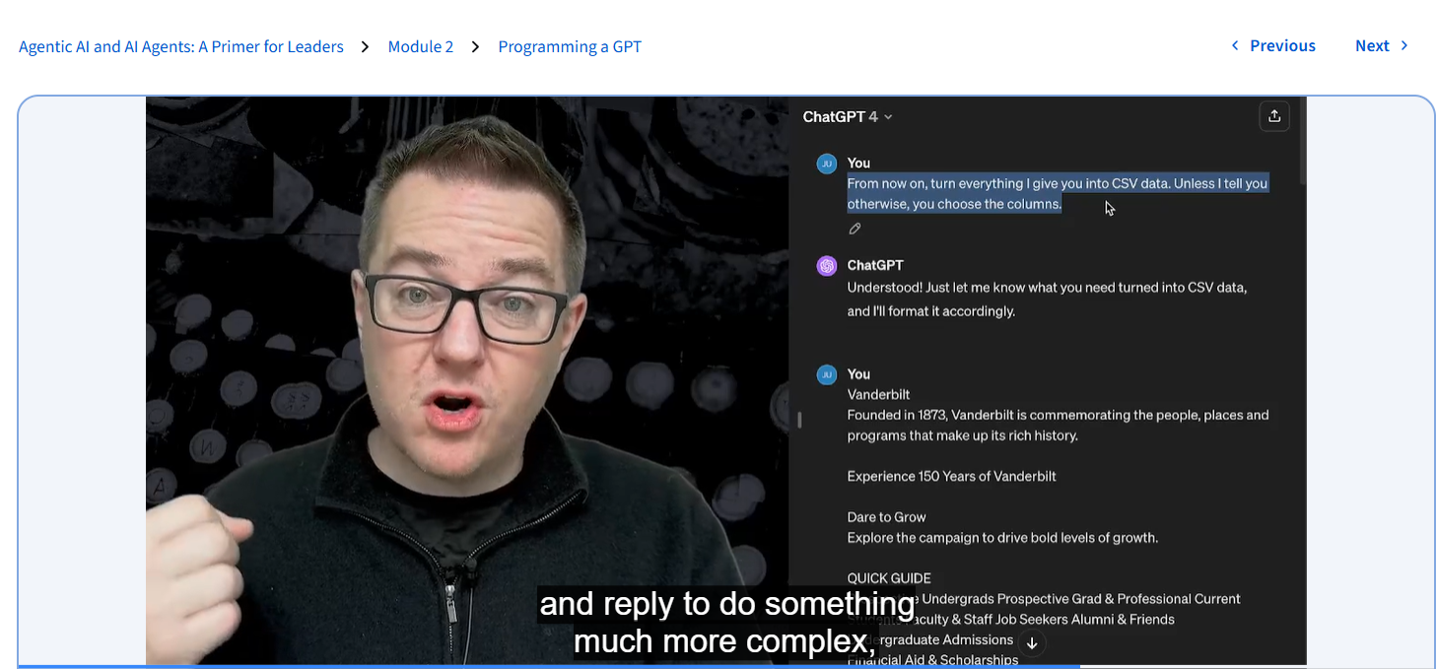

Slide 37
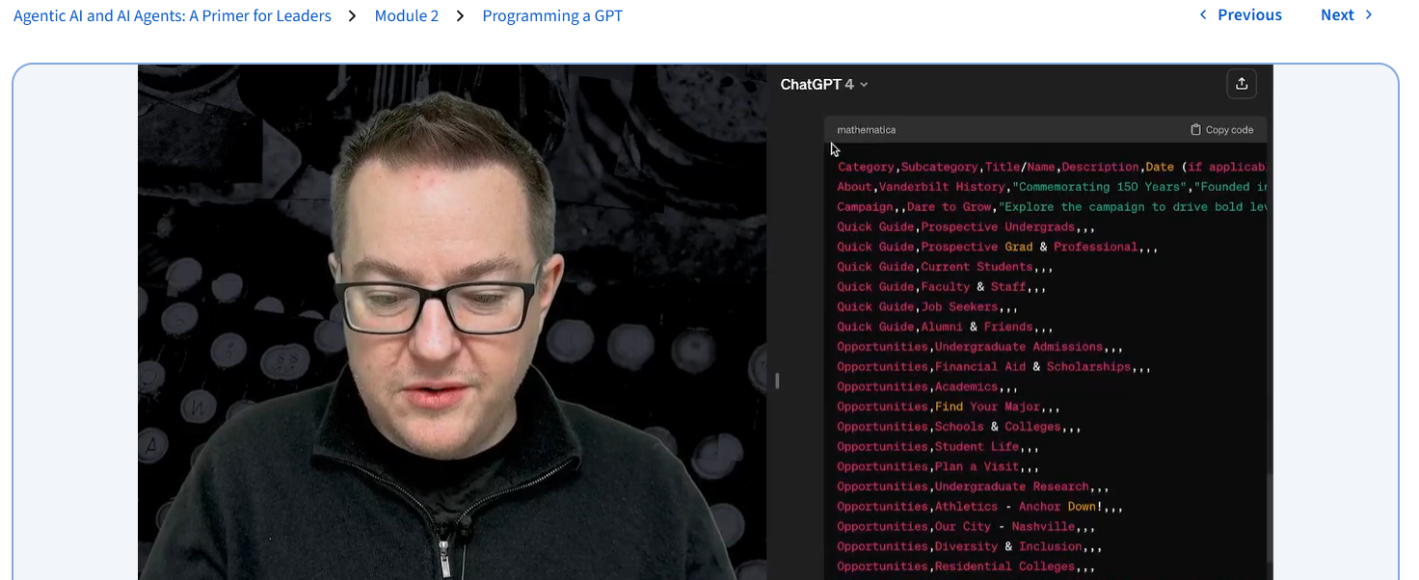

Slide 38
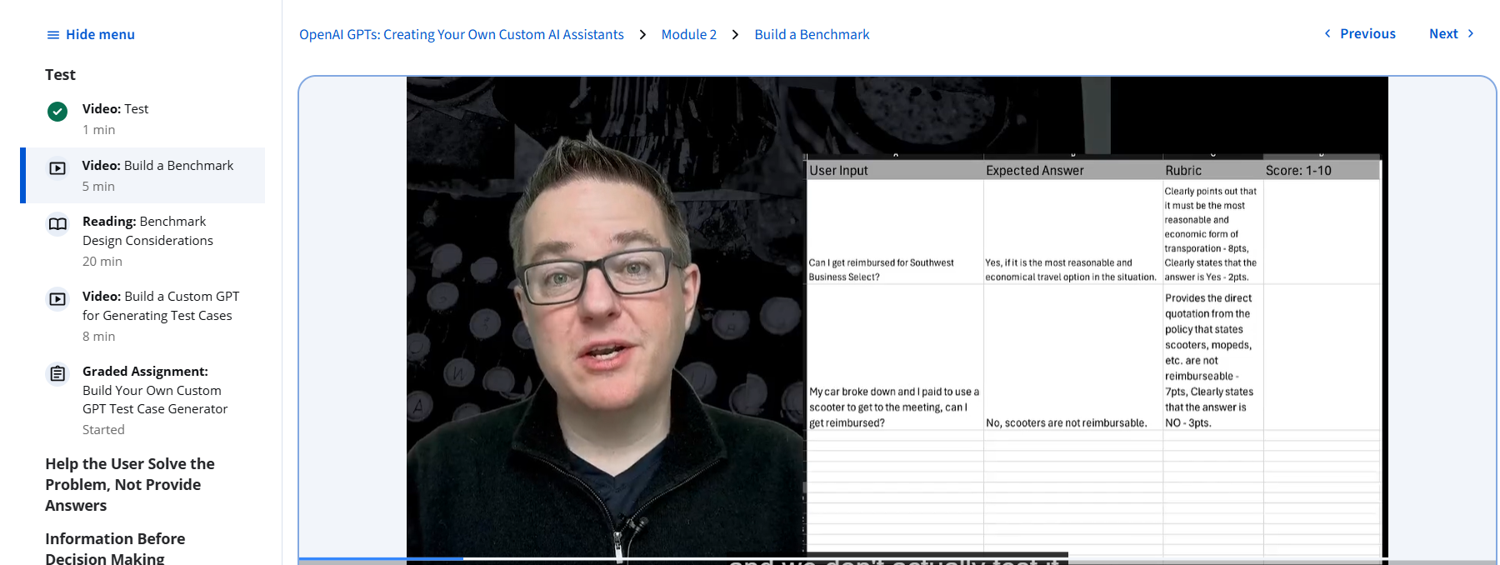

Slide 39


Slide 40


Slide 41


Slide 42


Slide 43


Slide 44


Slide 45


Slide 46


Slide 47


Slide 48


Slide 49


Slide 50
A rubric is a detailed set of criteria or guidelines used to assess the outputs of the system being tested.

